Slide 1
Pobal HP Deprivation Index
Presentation to CYPSC Network
Alana Ryan, Senior Research and Policy Officer
Martin Quigley, Director of Data & Analytics
19/03/24

Slide 2
Overview
Alana
Introduction to Pobal HP Deprivation Index
How it is constructed
Findings from 2022 Index
Martin
Usage
How it is used for resource allocation
New Pobal Maps

Slide 3
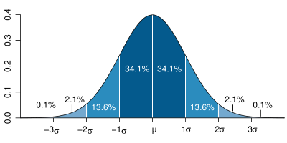
What is the Pobal HP Deprivation Index?
A tool to identify geographic disadvantage based on census data
Available on Pobal Maps
Used by us, other Departments & State Agencies and researchers
Data available for download at Electoral Division level on data.gov.ie, and at Small Area level on license with authors

Slide 4
Definition
The fundamental implication of the term deprivation is of an absence – of essential or desirable attributes, possessions and opportunities which are considered no more than the minimum by that society.
(Coombes et al., 1995)
Notes:
A key innovation with respect to the UK context is that we focus on the aggregate properties of local populations

Slide 5
Structure & Measures

Slide 6
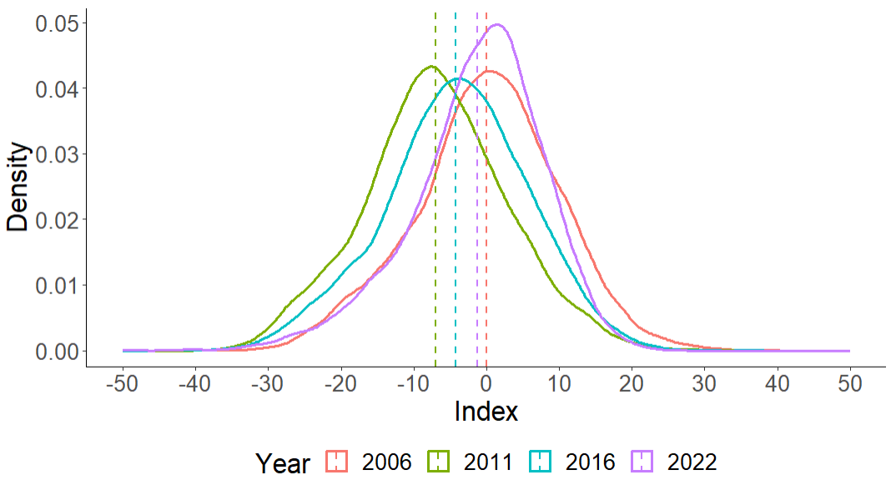
2022 Findings: Improvement of average
The average scores reflect periods of affluence (2006), recession (2011), partial recovery (2016) and return to previous levels (2022) driven mainly by:
Lower unemployment
Expansion of managerial/professional positions
Population Growth
Notes:
While birth rates in Ireland remains high by European standards, another contributor to positive demographic change, is inward migration. With immigration adding to demographic vitality and helping to offset the effects of population ageing.

Slide 7
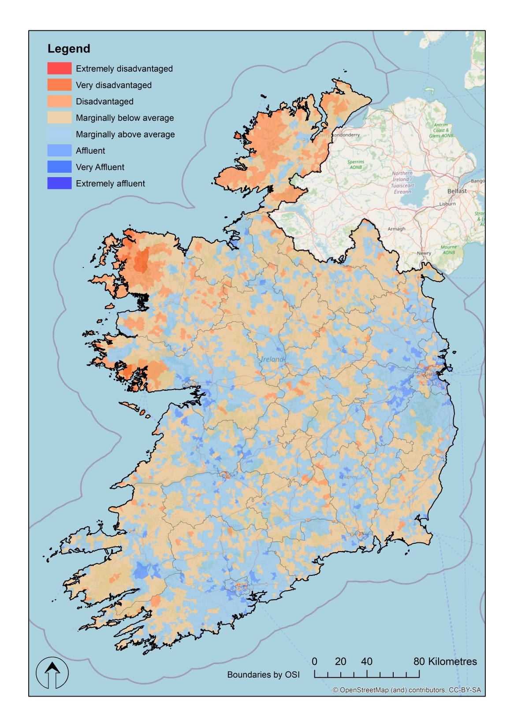
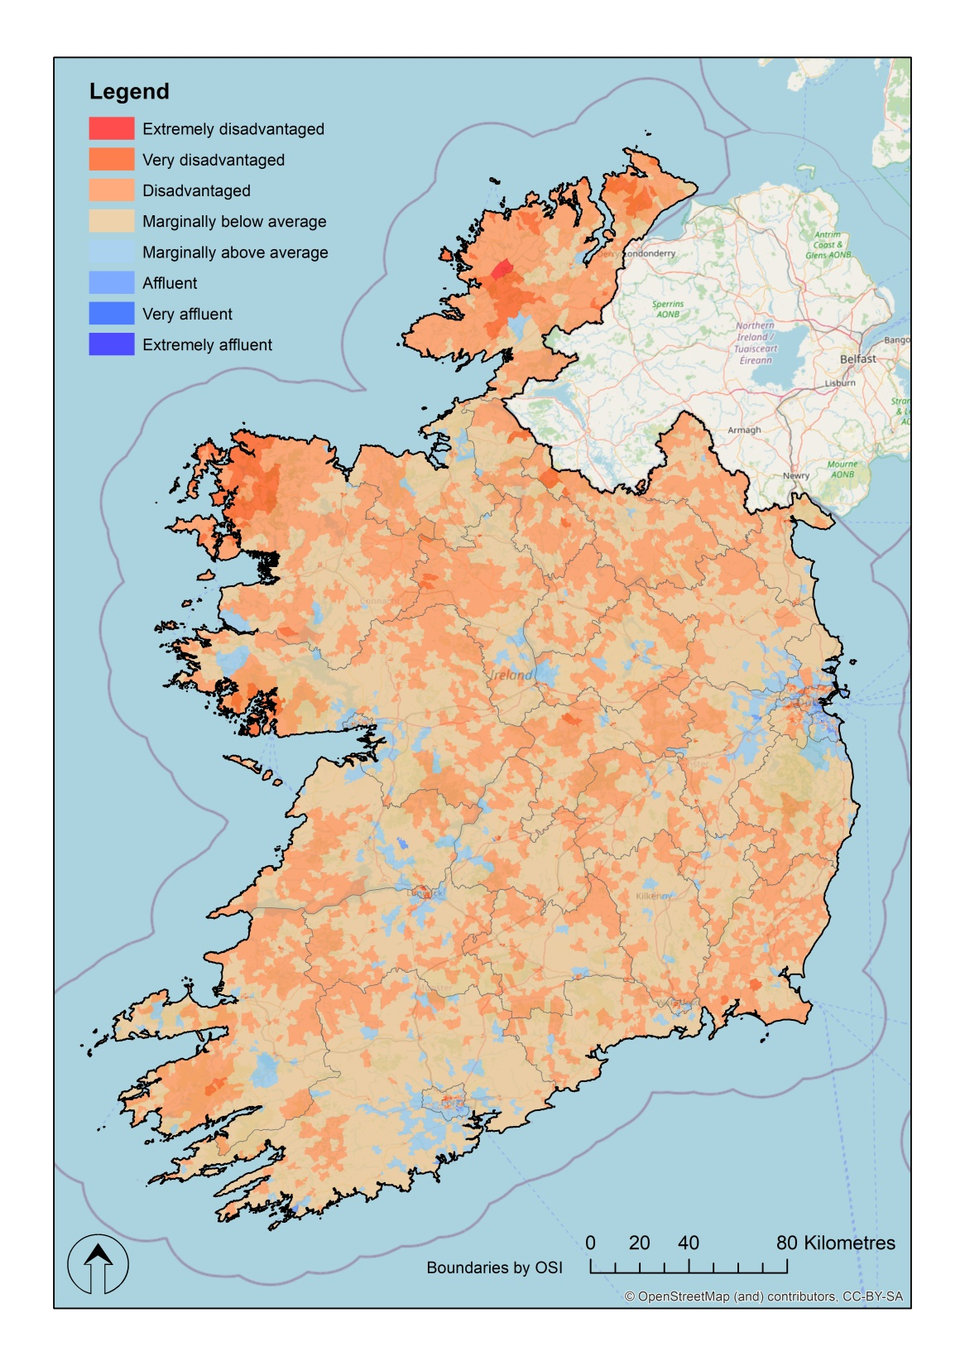
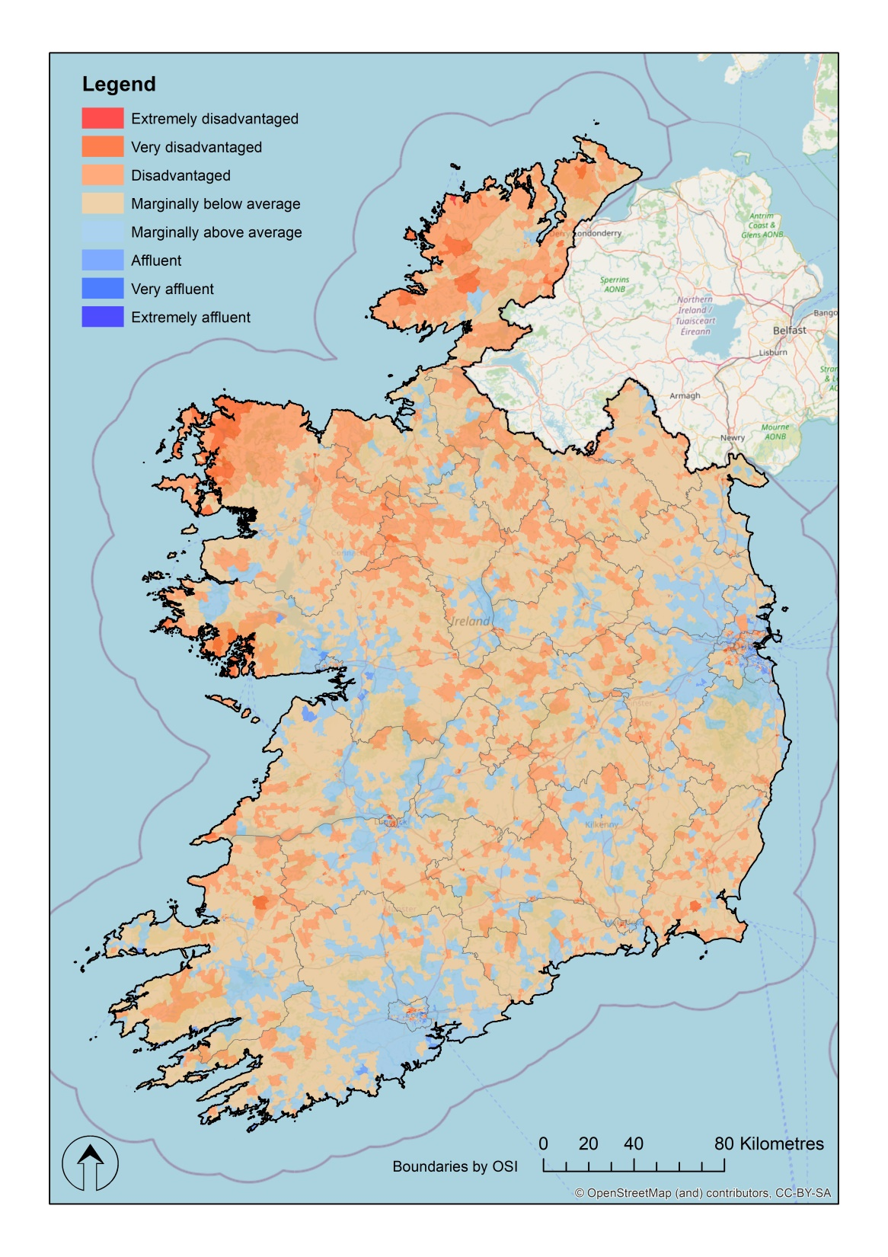
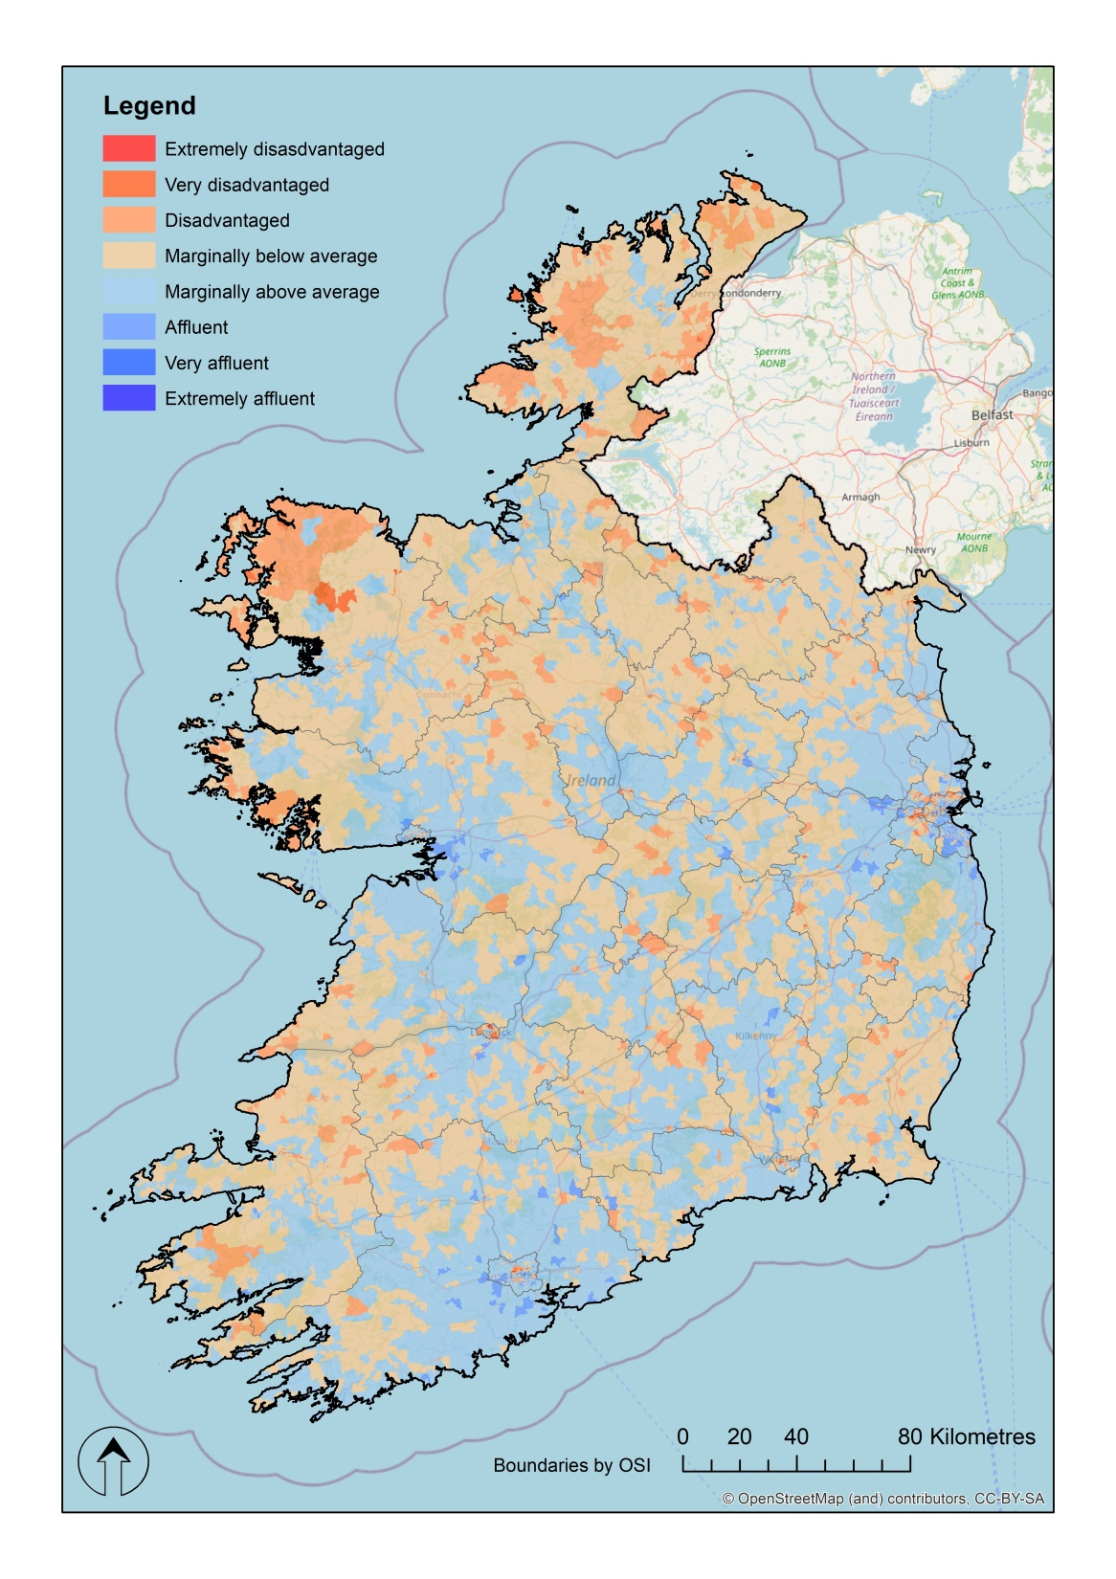
Absolute Scores
2006 2011 2016 2022
Notes:
While birth rates in Ireland remains high by European standards, another contributor to positive demographic change, is inward migration. With immigration adding to demographic vitality and helping to offset the effects of population ageing.

Slide 8
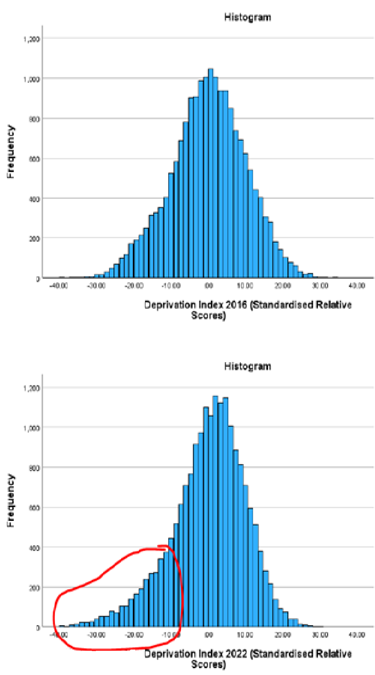
Disadvantaged areas are further from the average
2016: 143,506 people (3.0%)
2022: 195,734 people (3.8%)
Notes:
These areas continue to have much lower levels of educational attainment and significantly higher levels of unemployment than the national average, with the improvements seen in these measures nationally, not experienced by the most disadvantaged communities.

Slide 9
Geographical Differences
Disadvantage remains a spatially entrenched phenomenon
Parts of Dublin’s inner city, north and west suburbs
Parts of Cork, Limerick & Waterford
Housing estates in a number of rural towns
Many new estates are highly affluent

Slide 10
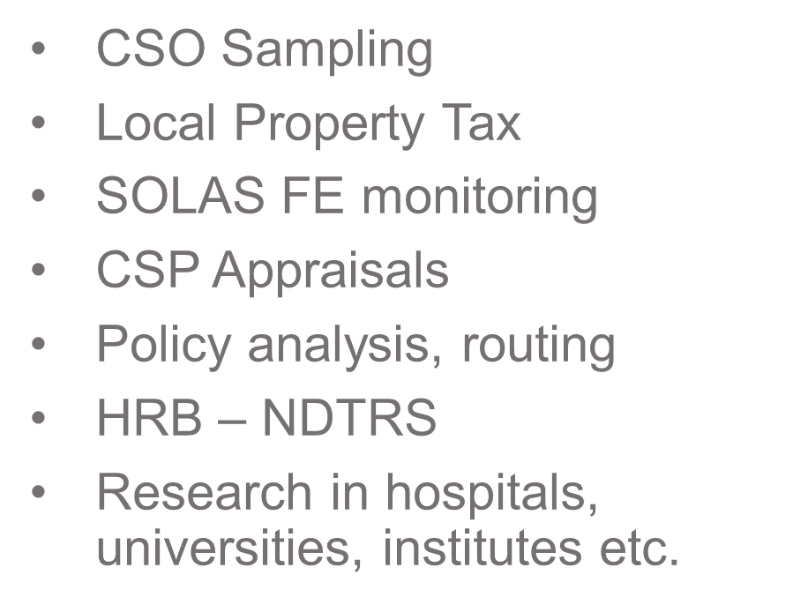
Resource Allocation
Major Uses
Others
SICAP, LEADER
CCC funding
HSE Resource Allocation
Sports Capital
DEIS School Designation
HEA funding model
Equal Participation Model

Slide 11
Resource Allocation Models
Optimization of allocation of a fixed sum of money across a set of predefined geographic areas.
Often uses deprivation as one input alongside others such as population, urban / rural designation, or bespoke measures such as square meterage of bogland.
Notes:
Spell out first line

Slide 12
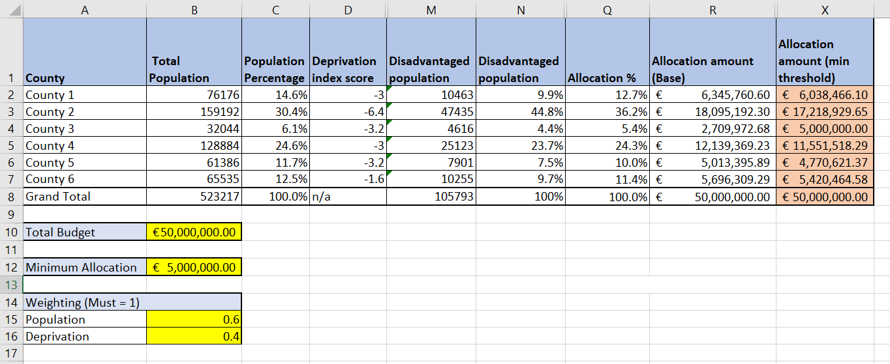
Usage – National Resource Allocation Models
Notes:
Spell out first line

Slide 13
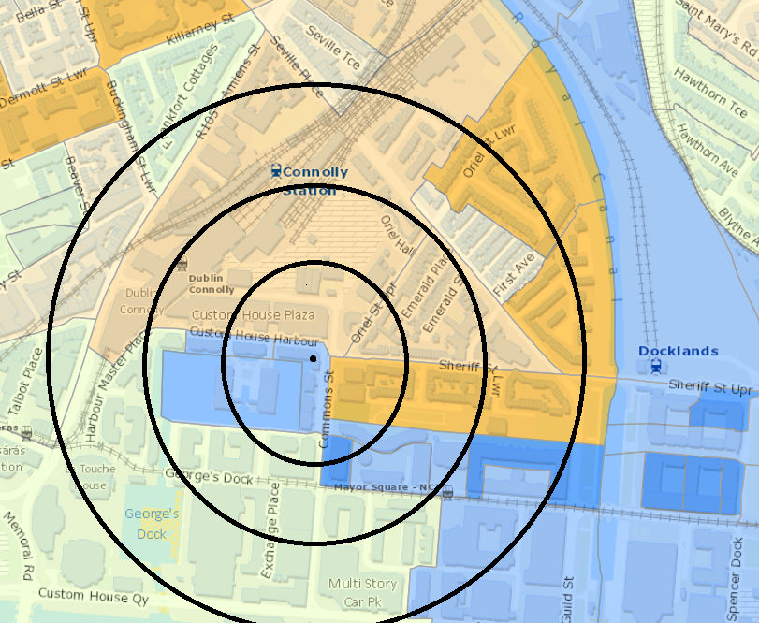
Usage - Setting specific scoring
Where each applicant is given a score as part of appraisal process
Can be score of boundary, or bespoke calculation
Challenges when used too simplistically

Slide 14
Pobal Maps Demonstration

Slide 15
Further reading
More info
Conceptual Model and technical description
Briefing on 2022 Findings
Pobal Maps
Electoral Division level dataset
Informal enquiries or access to Small Area level data – pobalmaps@pobal.ie
Notes:
Spell out first line

