Slide 1
Social Exclusion in
Ireland and Donegal
‘Re-imagining Disability’ - October 2018

Slide 2
What is Social Inclusion?

Slide 3
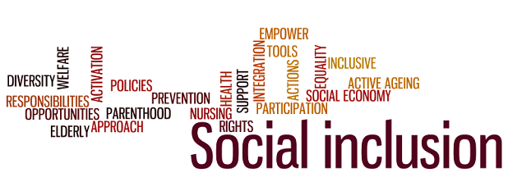
The SICAP Programme
Having an equal opportunity to:
Participate in:
Economic
Social
Political
Cultural and
Community life
Participate in:
decision making
on matters that affect our lives.

Slide 4
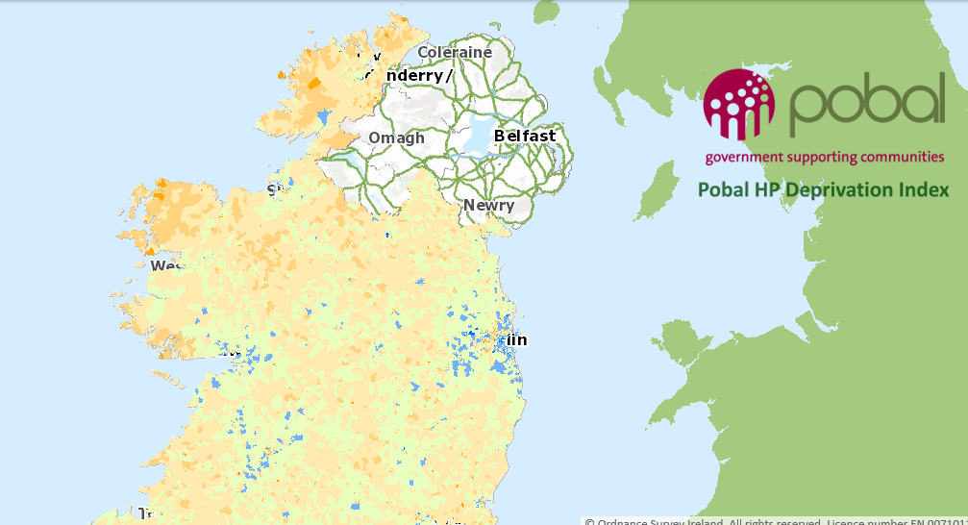
How do we know that social exclusion exists in Ireland?
Pobal Maps: https://www.pobal.ie

Slide 5
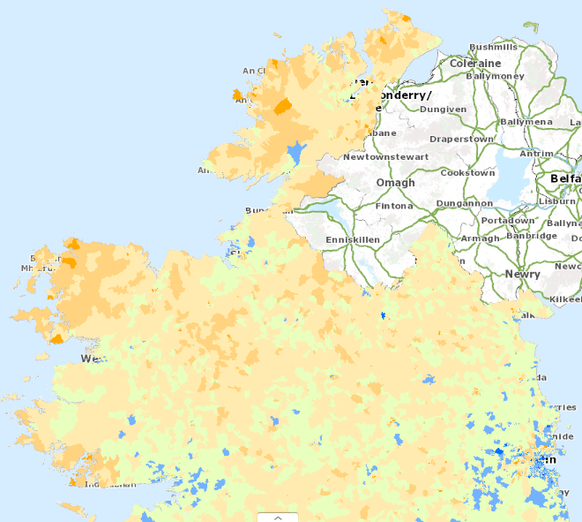
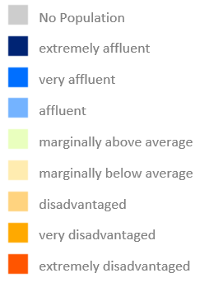
How do we know that exclusion exists in Ireland?

Slide 6
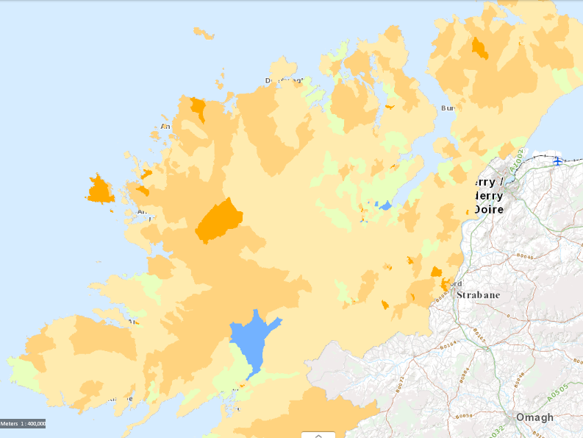
Social exclusion (disadvantage) in Donegal

Slide 7
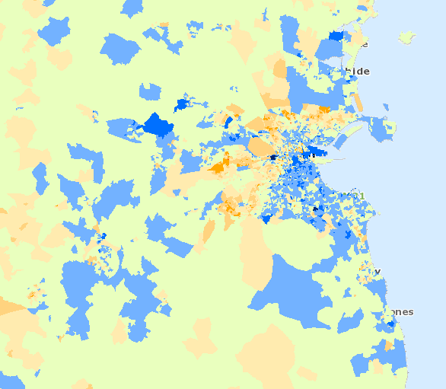
Social exclusion (disadvantage) in the Greater Dublin Area ?

Slide 8
What is Double or Multiple Disadvantage?

Slide 9
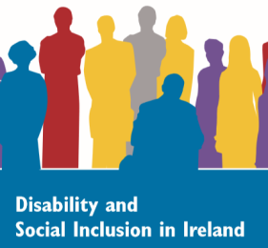
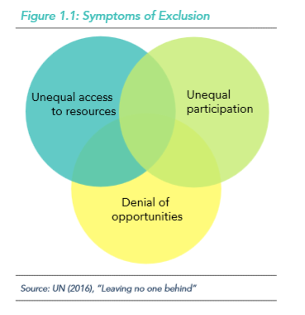
SICAP Programme: Double Disadvantage
Higher risk of being socially excluded in society
If you live in a disadvantaged area
Have a disability
There is statistical evidence for this:
↑ higher levels of early school leaving
↑ higher risk of social isolation
↑ higher risk of poverty
↓ lower levels of progression within education
↓ fewer opportunities to gain employment
↓ lower paid employment (earnings)
↓ fewer opportunities for social participation

Slide 10
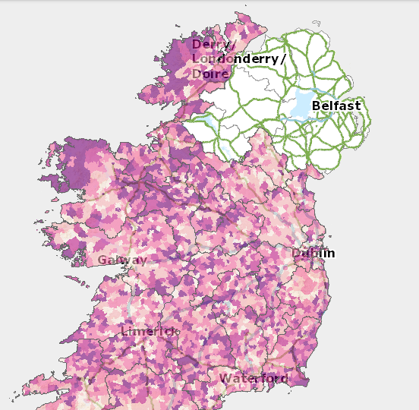
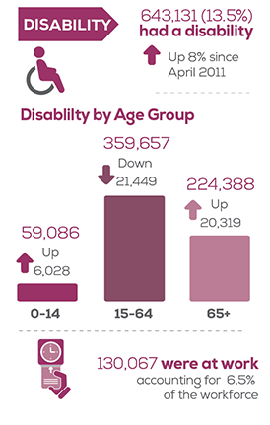
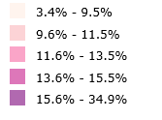
Disability in Ireland

Slide 11
Disability in Ireland:
Key Facts (Census 2016)
643,131 people in Ireland have a disability
13.5% of the total population of Ireland
103,726 children / young people
(0-24 years)
38,238 children at school
(aged 5-12 years)
31,103 students at school or college
(aged 13-18 years)
18,568 students at school or college
(aged 19 years and over)
Table I:
Children & Young People with a Disability
Age Group | Total
0-4 years | 1,053
5-9 years | 22,851
10-14 years | 26,357
15-19 years | 28,512
20-24 years | 24,953
Total | 103,726

Slide 12
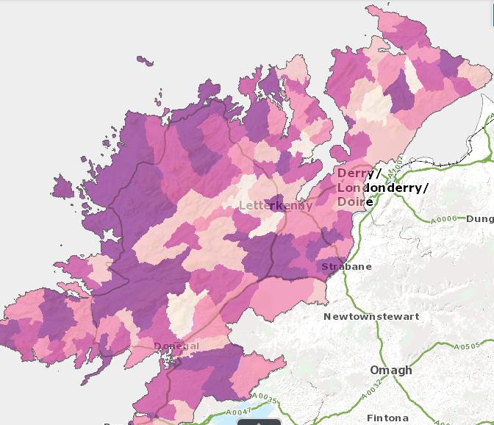
Disability in Donegal
Town | Population | People with Disability
Letterkenny | 19,274 | 2,792
Buncrana | 6,785 | 979
Ballybofey-Stranorlar | 4,852 | 858
Ballyshannon | 2,299 | 445
Donegal Town | 2,618 | 414
Carndonagh | 2,471 | 390
Bundoran | 1,963 | 348
Convoy | 1,526 | 318
Lifford | 1,626 | 293
Towns | Total | 6,807
Rural Areas | Total | 16,148

Slide 13
Disability in Donegal:
Key Facts (Census 2016)
159,192 people live in Donegal
22,955 people in Donegal have a disability
14.4% of the total population of Donegal
53,449 children / young people in Donegal
Estimated 7,696 children / young people
with a disability (0-24 years)
7,211 people are carers
Table I:
Children & Young People with a Disability
Age Group | Total
0-4 years | 1,552
5-9 years | 1,792
10-14 years | 1,702
15-19 years | 1,563
20-24 years | 1,087
Total | 7,696

Slide 14
Disability in Donegal:
Key Facts (Census 2016)
Total | Disability Type
10,051 | A condition that substantially limits one or more basic physical activities
7,805 | Difficulty in working or attending school/college
7,269 | Difficulty in going outside home alone
5,559 | Difficulty in learning, remembering or concentrating
5,425 | Difficulty in dressing, bathing or getting around inside the home
4,357 | Deafness or a serious hearing impairment
3,913 | Psychological or emotional condition
2,354 | An intellectual disability
2,068 | Blindness or a serious vision impairment
8,640 | Difficulty in participating in other activities
10,366 | Other Disability, including chronic illness
67,807 | Total

Slide 15
Disability: Social Inclusion - ‘One Donegal’

Slide 16
One Donegal
Statistics only evidence exclusion
Involve people in decision making – nothing replaces talking to people who have real lived experience
Remember the barriers presented by society itself:
The physical environment
The design and organisation of:
Support programmes
Services
Education
Work
Social activities
Public attitudes and discrimination
Positive action can remove barriers to participation in society
Work together towards equal opportunity of outcomes

Slide 17
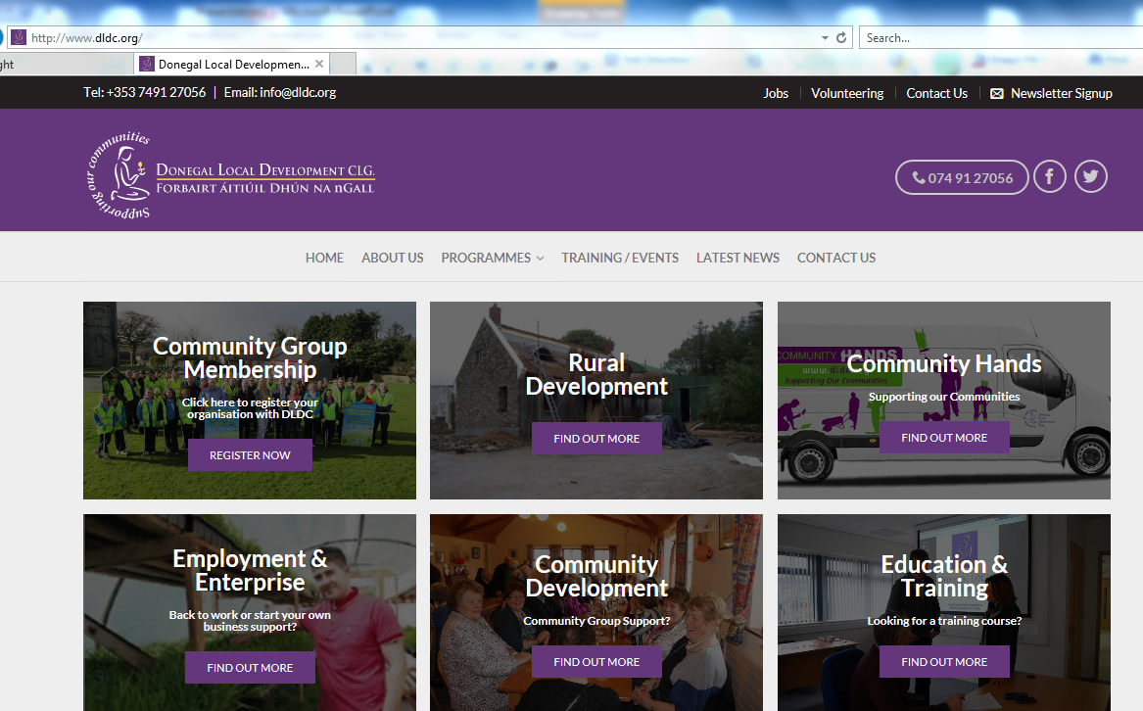
Thank You
Stephen Barrett 07491 27056 sbarrett@dldc.org
Donegal Local Development Company CLG www.dldc.org

