Slide 1

Responding to Child and Adolescent Anxiety. What a parent can do.
Dr Tara Kelly
New Authority Parenting

Slide 2
What this session will cover
A quick look at anxiety rates
The impact of anxiety on families
Common pitfalls for parents
Family Accommodation
Taking a new position in relation to the anxiety – what you can do.
Based on SPACE (Supportive Parenting for Anxious Childhood Emotions) (Lebowitz and Omer, 2013)
Yale Centre for Childhood Anxiety Disorders

Slide 3
Anxiety
Most common mental health disorder for children and adolescents
The most treatable of mental health problems for children
A disorder or a problem?
Jigsaw : 49% of adolescents report experiencing levels of anxiety that lie outside the normal range. (Dooley, 2019)
Many parents seeking services and long waiting lists

Slide 4
Impact of anxiety on families
Parents can feel controlled by the child's anxiety
Family plans can be significantly impacted
Constant demands
Exhausted
Helpless and hopeless

Slide 5


Slide 6
Why parents?
Parents are not to blame for their child's anxiety
Parents can become very involved with their child's anxiety
Parents can be part of the solution
There are many pitfalls in managing a child with anxiety

Slide 7
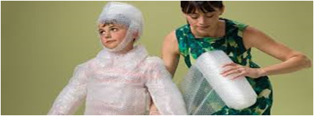

Protecting Demanding

Slide 8
Common pitfalls
PROTECTING
My child is vulnerable
He needs to be protected
She can't handle stress
He needs a softer touch
My job is to make her as comfortable as possible
DEMANDING
He needs to toughen up
There's nothing to be afraid of
Why can't she be more like her sister
He's just clingy and looking for attention

Slide 9
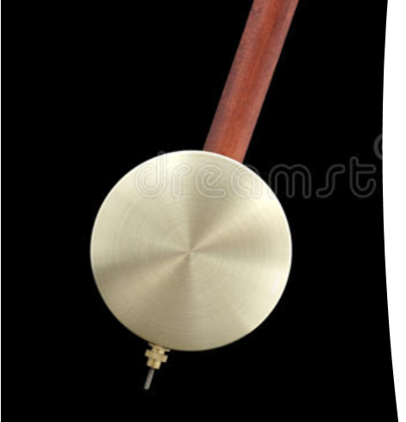
From protecting to demanding
"She finds it too hard. She can’t manage“
"There's no need to be afraid. All the kids can do it".

Slide 10
Introducing accommodation
Family accommodation of childhood anxiety refers to the countless changes that parents and family members make to their own behaviours or actions due to childhood anxiety.
“Accommodation” refers to the way parents’ urge to protect and reassure their child may reinforce the child’s anxiety by hampering the development of their ability to regulate their own emotions.

Slide 11
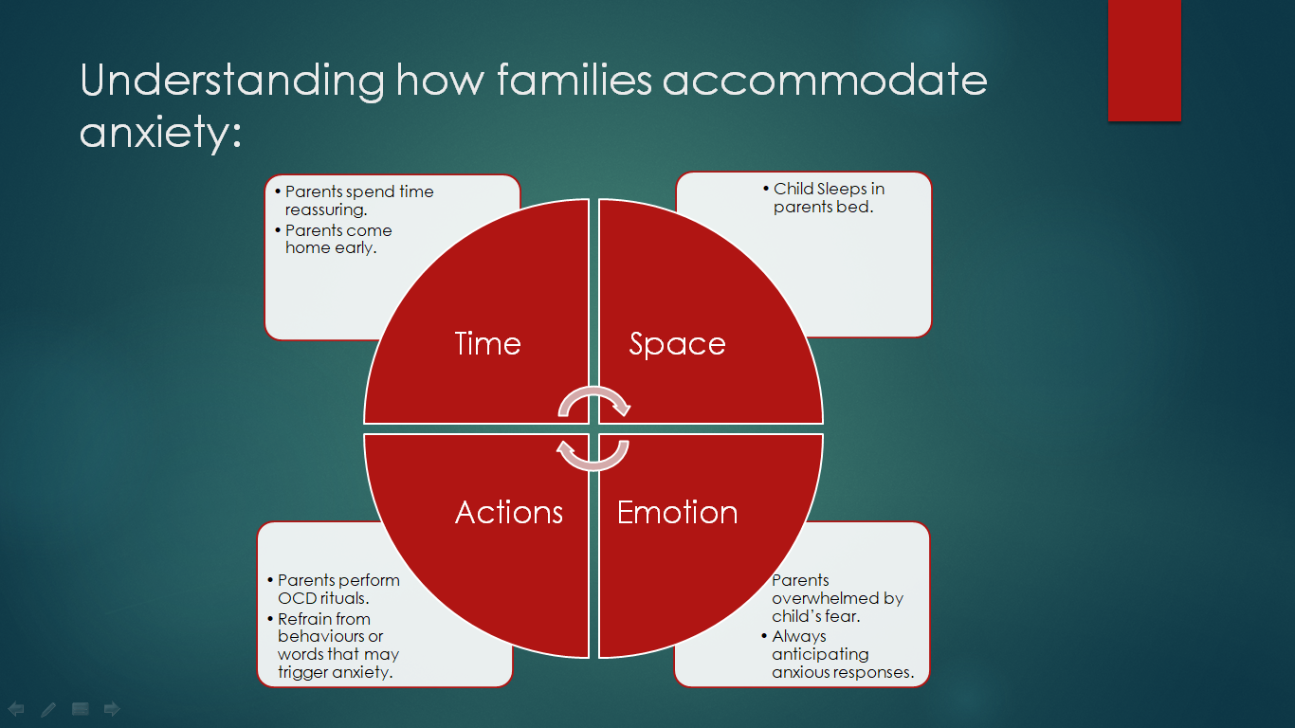

Slide 12
Think about how you might accommodate your child's anxiety?
Constant reassurance
Speaking for your child
Spending long periods of time with your child at bed-time
Avoiding certain places
Checking lights, switches
Allowing your family to avoid social events, places, activities

Slide 13

Why parents accommodate
Find it hard to see their child upset
Easier just to do it!
Worry about the child's reaction
To keep the peace in the house
Belief that your child cannot manage
Almost 100% of parents accommodate. Some accommodations can be helpful.

Slide 14
Participation – Parents become skillful at anticipating anxious responses, will begin preventing by taking advance action in their accommodating behaviours. Participation can also occur when parents participate in refraining from certain behaviours which may trigger the anxiety.
Modification – The organisation of family life and modifying family routines around the child’s anxiety.

Slide 15
Questions
How much of your time is taken up by your child's anxiety?
What are you doing differently for this child (compared to siblings)?
What would you do differently if your child was not anxious?
How do you accommodate?
What is stopping you from making a change?

Slide 16
What can we do?
Acceptance
Support
Confidence

Slide 17
Making a plan
Prepare as much as possible (see links to book and talks)
Choose an accommodation
Expect the process to be challenging
Inform your child
Increase support for your child
Prepare for difficult responses

Slide 18
Sarah. You have been very worried about the electrics at nighttime. We can really see how hard this is for you and how scared you are that something might happen in the house. But we also know that you are strong and that you will be able to deal with the worry. We have been checking the electrics many times each night and now we realise that we are not helping you to overcome your fear. We have decided to make a change so that we can help you. We are not going to check the electrics every night but we will do the normal safe routine. We will not be answering questions but we will remind you of our plan just once. We know this change will be hard for you but we really believe you can deal with the worry. We love you so much and are determined to support you with this.

Slide 19
Where to from here?
Stay supportive
Remain anchored
Avoid escalations
Build on your relationship
Success means not accommodating
Success means child gets through the anxiety (not feels it less).
Self-care is essential

Slide 20
https://www.youtube.com/watch?v=VUayeUlc_Gs&t=1587s
https://www.youtube.com/watch?v=-9bTiuCNzus
https://www.youtube.com/watch?v=4SLWKgbWfug
https://www.youtube.com/watch?v=76RbLoNra_A&t=1619s
https://www.kidsskills.org/

Slide 21
Books
https://www.bookdepository.com/Breaking-Free-Child-Anxiety-OCD-Eli-R-Lebowitz/9780190883522?ref=grid-view&qid=1647349847980&sr=1-1
https://www.bookdepository.com/Outsmarting-Worry-Dawn-Huebner/9781785927829?ref=grid-view&qid=1647349866248&sr=1-1

