Slide 1
“WHAT’S WRONG WITH YOU” VS “WHAT HAPPENED TO YOU”
Presented by
Gail Erisman Valeta, MA Th., MA Conflict Resolution
erismanvaleta@gmail.com

Slide 2
WHAT HAPPENED TO YOU? - Oprah Winfrey & Dr. Bruce Perry

Slide 3
Comparing two brains of a 3 year old child
Chronological age Developmental age

Slide 4
LIZARD BRAIN - WIZARD BRAIN

Slide 5
ACTING IN
Substance abuse including alcohol
Overwork
Eating too little/too much
Depression, numbness, anxiety
Self-blame, shame, self-harm, suicide
Physical symptoms: high blood pressure, pain (chest, back, joints),
headaches, digestive trouble.

Slide 6
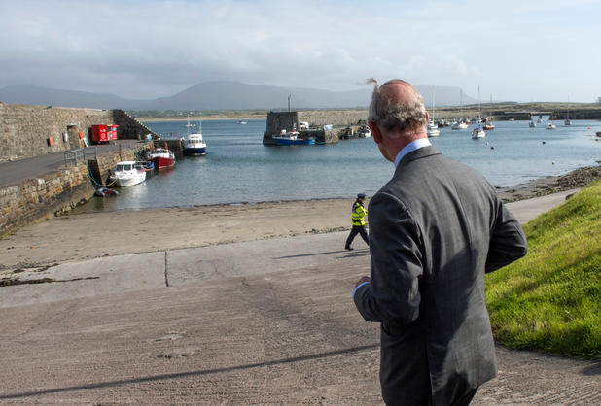
LORD MOUNTBATTEN & PRINCE CHARLES
Prince Charles paid a visit to Mullaghmore in 2015 to visit the site where Mountbatten’s fishing boat ‘Shadow’ was blown up by the IRA out at sea in August 1979. Mountbatten owned Classibawn Castle nearby where he went for holiday time.
Uncle Louis was a much loved member of the royal family and acted as a mentor for the young Prince Charles in the emotional absence of his father.

Slide 7
ACTING IN - DEBRIEF
In Groups of 3-4.
Can you relate examples/experiences to any Cycles of Violence on the chart?
How do you see this Cycle
- impacting NEWCOMERS?
- impacting People in the church?

Slide 8
ACTING OUT
Repetitive violence, occupation, war
Domestic abuse and child abuse
Inability to show empathy to others, be flexible or tolerant of other perspectives, including in faith/religion
Sexual violence
High-risk behaviors
Lawlessness
Attacks on persons and symbolic property
Disregard for Earth and environment
Difficulty and blame in intimate relations
Hoarding resources

Slide 9
ACTING OUT - DEBRIEF
In Groups of 3-4.
What do the Cycles of Violence look like in your setting?
What do Cycles of Violence look like in families? In your communities?
In your church? In your nation?

Slide 10
MULTI-GENERATIONAL IMPACTS OF TRAUMA Adverse Childhood Experiences (ACE’s)
The Study Named some adverse childhood experiences:
Physical, sexual and verbal abuse.
Physical and emotional neglect
A family member who is: depressed or diagnosed with other mental illness; addicted to alcohol or another substance; or in prison.
Witnessing a mother being abused.
Losing a parent to separation, divorce or other reason.

Slide 11
ACE’S INTERVIEW w/TIM GROVE & OPRAH WINFREY on 60 MINUTES
Tim Grove has 2 FREE webcasts that explains ACE’s and Trauma Informed Care (TIC).
www.mcpherson.edu/ventures/courses (Look for 2018-2019 course ACE’s Part 1, TIC Part 2)
IT’S FREE!!!

Slide 12
BREAKING FREE: MY RESILIENCE NETWORK
1. Great Listener(s)
2. Inspiring Person(s)/visionary(ies)
3. Super Practical Person(s)
4. Someone who can make me laugh
5. Someone who reminds me that I am beautiful
6. Mentor(s)/elder(s) – someone who’s been through it all

Slide 13
ACKNOWLEDGEMENT - DEBRIEF
In Groups of 3-4
How have any of these ACKNOWLEDGEMENT tools been used in the families you serve?
In your church? In your community or other communities?

Slide 14
RECONNECTION - DEBRIEF
In Groups of 3-4.
What tools of RECONNECTION have you seen being implemented/or helped implement?
What has worked to help people break free of the Cycles of Violence?

Slide 15
TOOLS TO HELP BREAK FREE OF TRAUMA
Connecting to loved ones
Sports/Exercise
Music/Singing/Humming
Massage/touch – a hug
Prayer/meditation
Being in Nature
Pets
Dancing/drumming
Painting/Sculpting
Rituals/worship

Slide 16
AMYGDALA

Slide 17
STAR STRETCH
Light of Life (raise arms overhead)
Help me to be flexible (bend toward one side)
And resilient (bend to other side)
Help me face the past (arms up, gentle back bend)
And let go of what I need not carry (fold forward)

