Slide 1
WHAT WE DO
AND WHY…

Slide 2
THE WHY…
“ I THINK THE HARDEST PART OF CARING FOR A CHILD WITH ADDITIONAL NEEDS OF ANY KIND IS THE FIGHT: THE FIGHT FOR SERVICES, THE FIGHT FOR UNDERSTANDING, THE FIGHT FOR ACCEPTANCE, THE FIGHT FOR INCLUSION, THE FIGHT FOR KNOWLEDGE, THE FIGHT JUST TO BE HEARD.” a tired mum
THE HARDEST PART IS THAT ISOLATED, LONELY, PANIC STRICKEN, QUIET FIGHT YOU HAVE WITH YOURSELF AS A PARENT AND CARER, WONDERING IF YOU HAVE LEFT NO STONE UNTURNED.

Slide 3
DESPITE OUR INNER TURMOIL, WE ARE PARENTS FIRST
DESPITE OUR CHILDREN’S EXTRA NEEDS, THEY ARE CHILDREN FIRST
DESPITE OUR CHAOS, WE ARE A FAMILY FIRST

Slide 4
WHY THE BLUESTACKS
HISTORY – HOW WE STARTED – THE LIVED EXPERIENCE
HISTORY – HOW WE EVOLVED – FROM BLUESTACK CHALLENGE TO FOUNDATION
HISTORY – WHAT WE HAVE LEARNED
PEOPLE NEED A PLACE – A NON JUDGEMENTAL SPACE
PEOPLE LEARN MORE FROM EACH OTHER – THAN FROM PROFESSIONALS
PEOPLE STILL NEED SUPPORT – AND NOT JUST DISABILITY SPECIFIC SUPPORT – BUT SERVICES SUCH AS FAMILY SUPPORT – THEY ARE STILL A FAMILY
GENERIC SUPPORTS OFTEN JUST NEED A BIT OF TWEAKING TO BE RELEVANT AND SUPPORTIVE

Slide 5
Moving from accepting diversity to true inclusion
We have also learned that moving from accepting diversity to real inclusion can require a shift in our mindset.
We understand that full and authentic inclusion has more to do with complete membership of a community…

Slide 6
INCLUSION IS NOT A PROGRAMME
IT IS A MINDSET.
IT IS THE WAY WE TREAT OTHERS AND THE WAY OTHERS TREAT US
IT IS THAT FEELING THAT YOU BELONG
THAT FEELING THAT YOU ARE PART OF SOMETHING
AND IT IS THE RIGHT THING TO DO.
WHERE WE ARE NOW… WE HAVE A PLACE TO BELONG TO

Slide 7
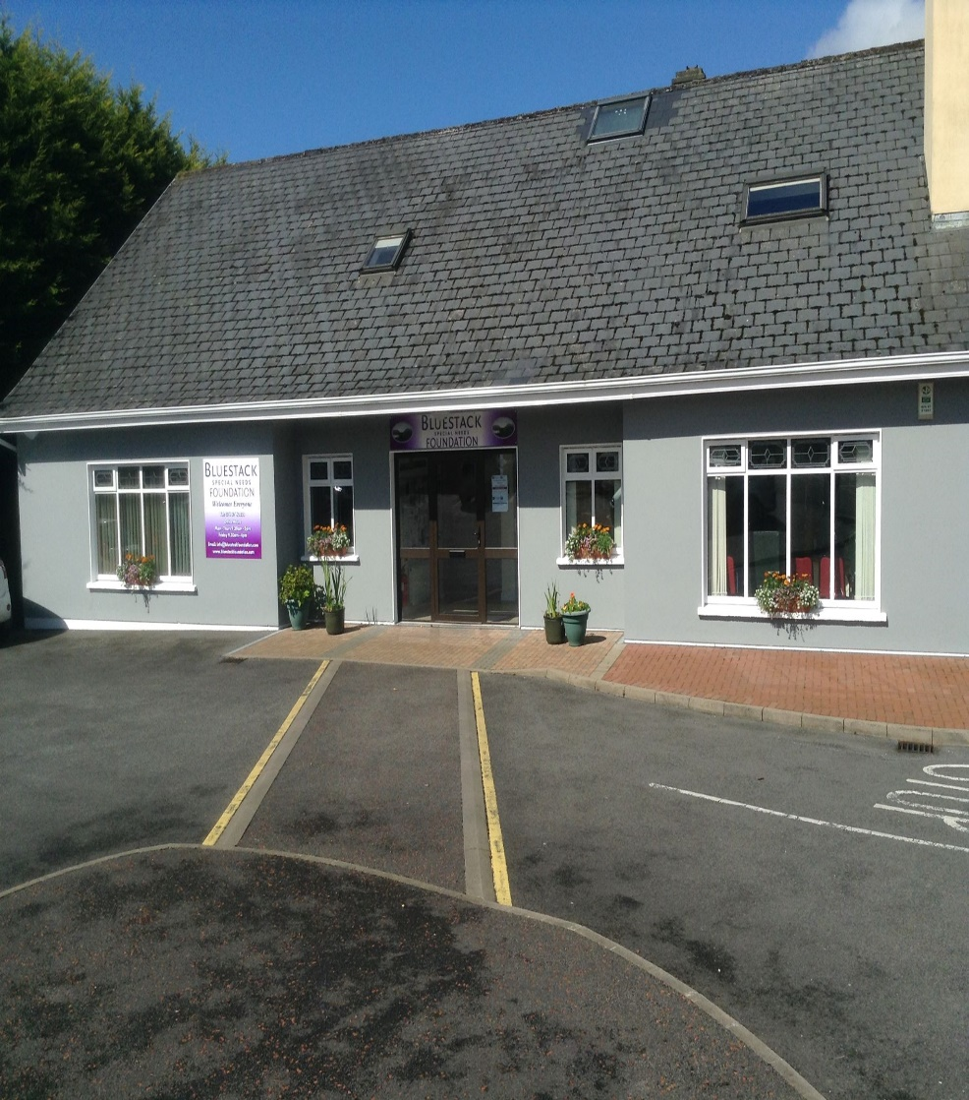
We Created the Space - Adapted and Accessible building in Donegal Town

Slide 8
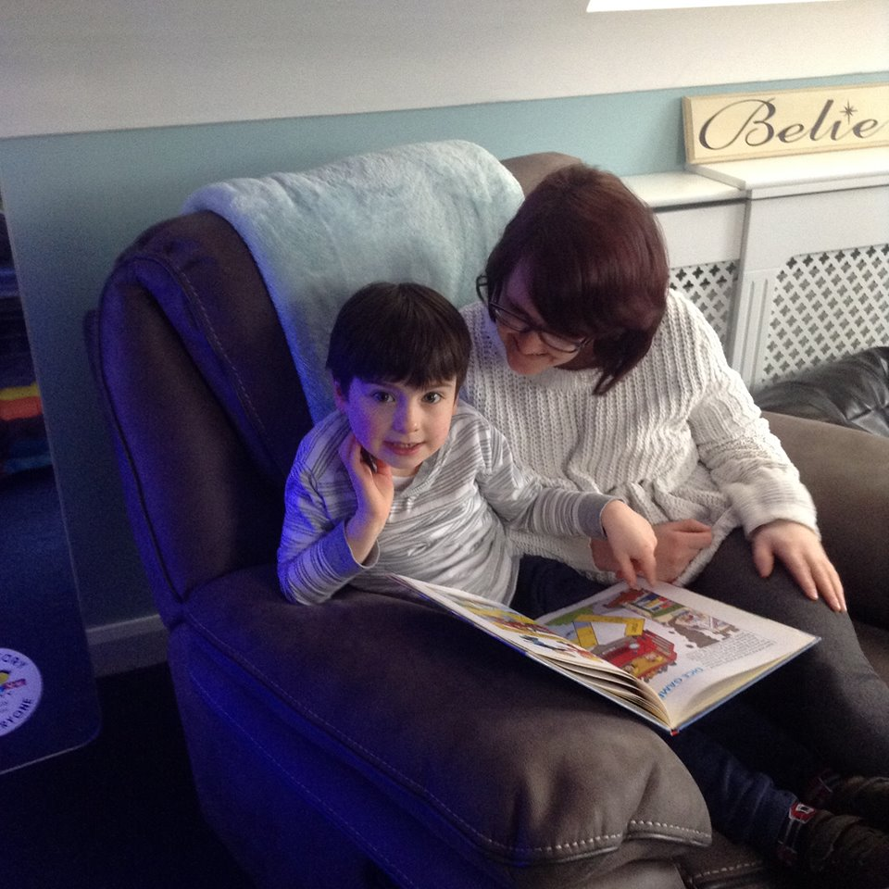
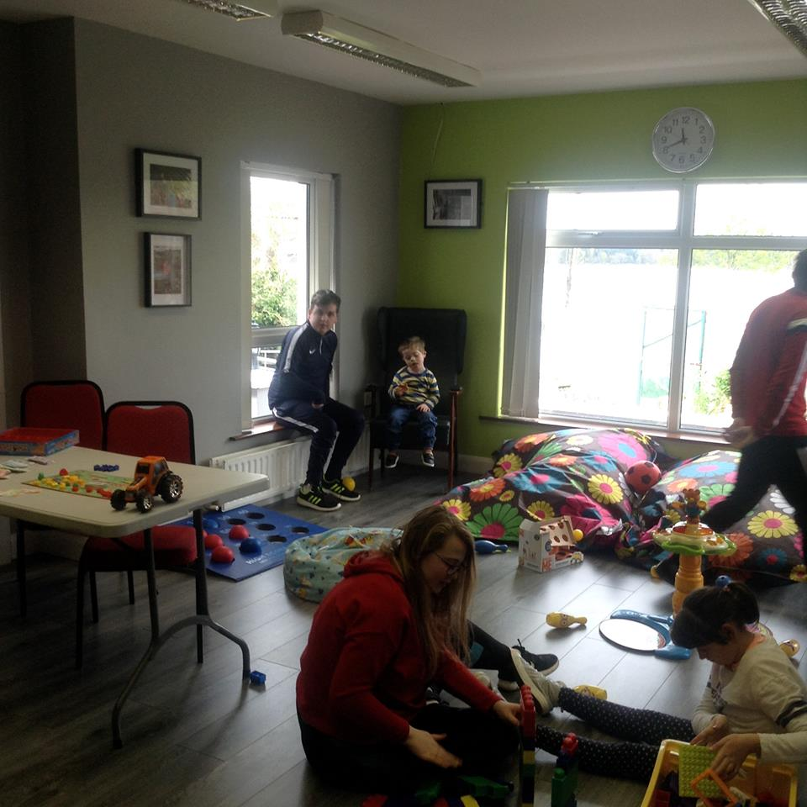
PROGRAMMES – SATURDAY CLUB

Slide 9
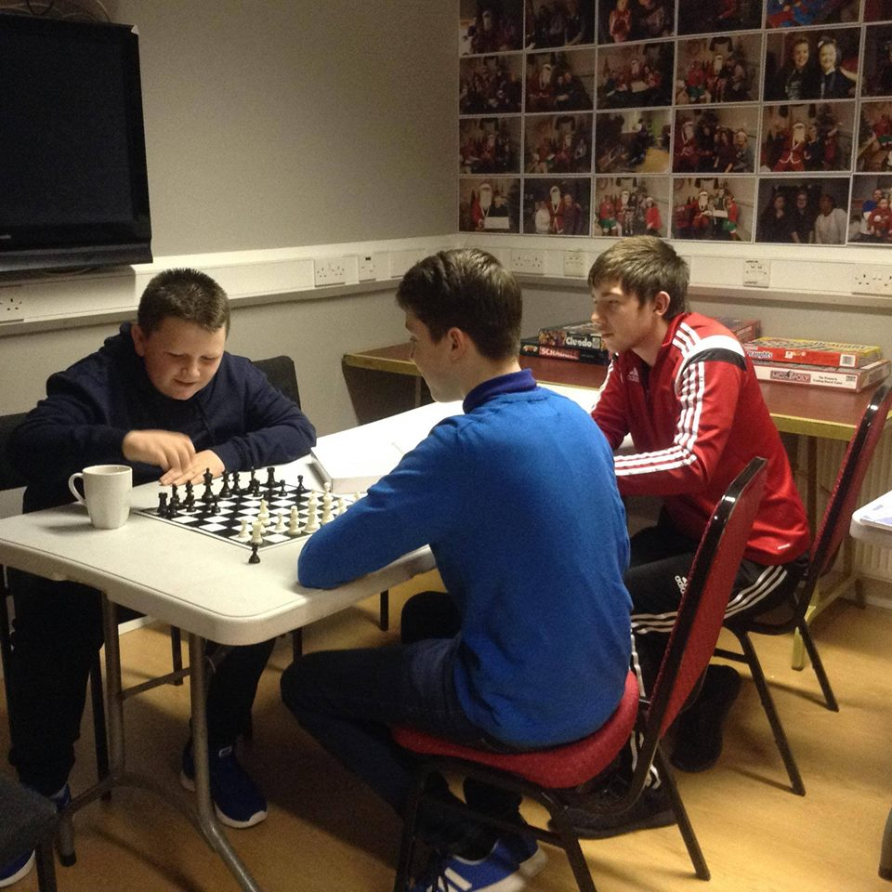
BLUESTACK YOUTH CLUB

Slide 10
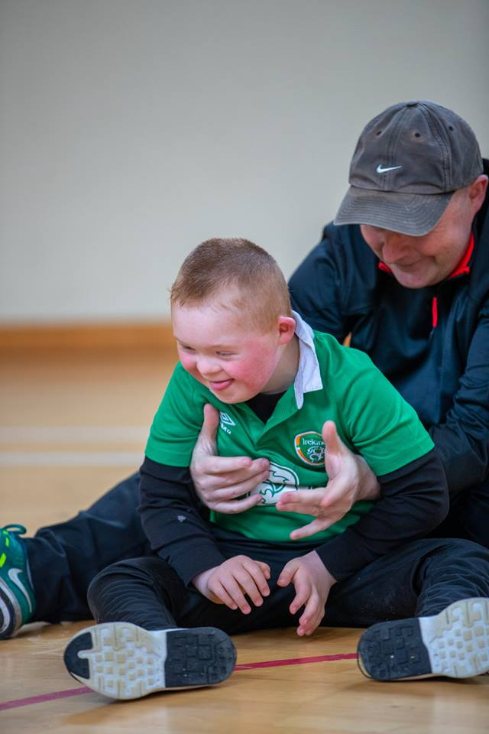
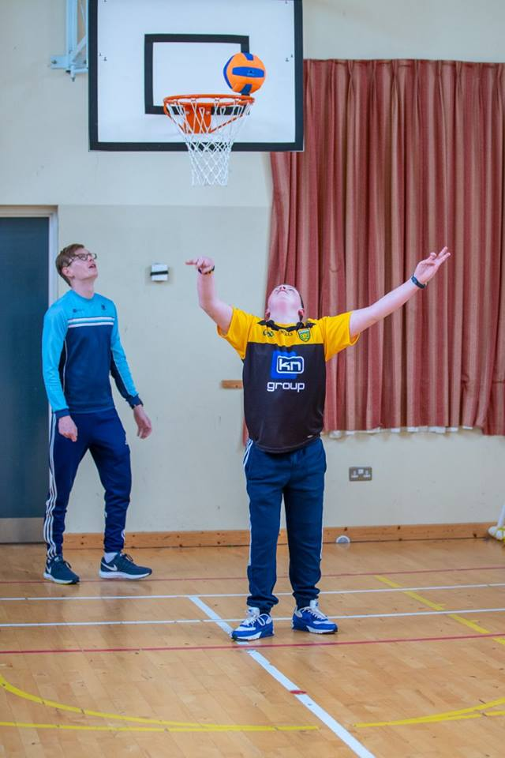
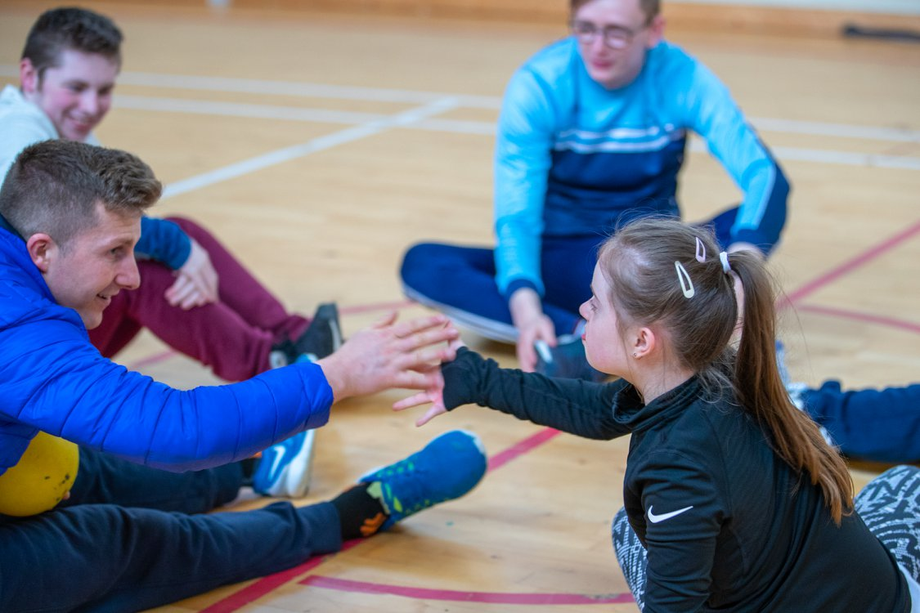
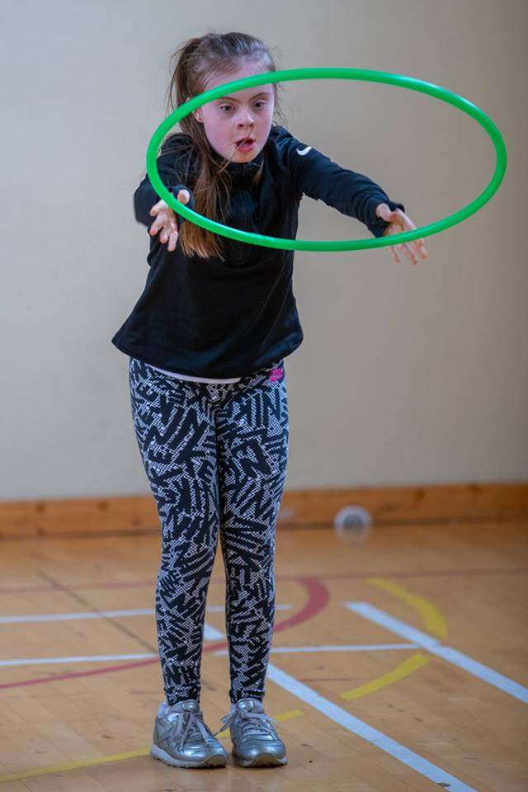
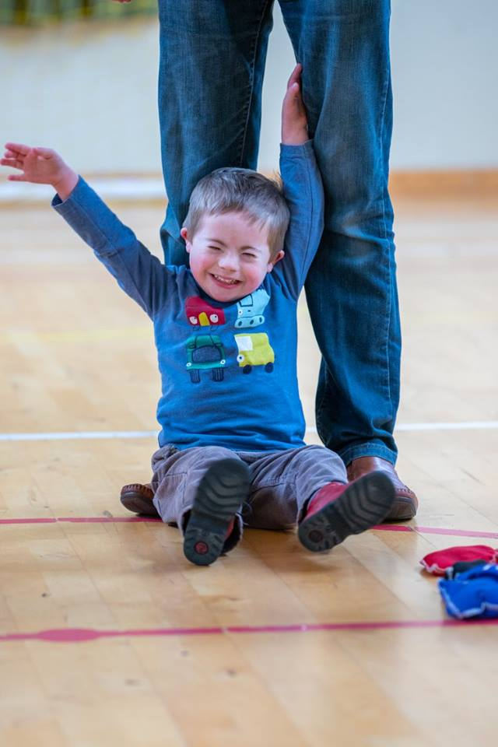
FUNDAMENTAL MOVEMENT PROGRAMME GROSS AND FINE MOTOR SKILL DEVELOPMENT

Slide 11
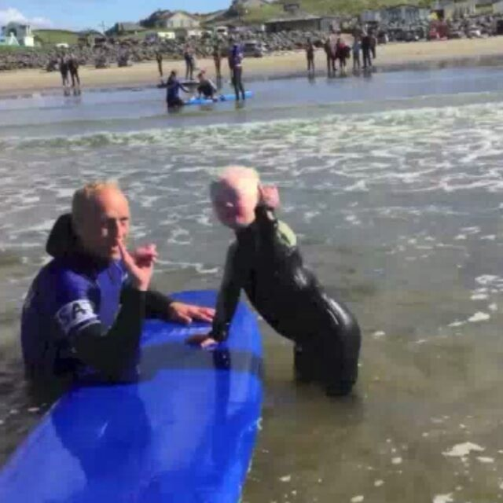
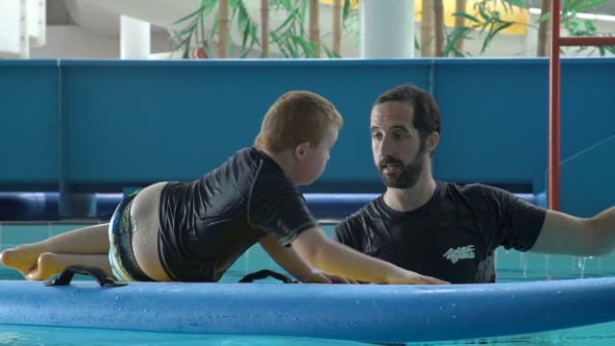
BLUESTACK SPORTS PROGRAMME

Slide 12
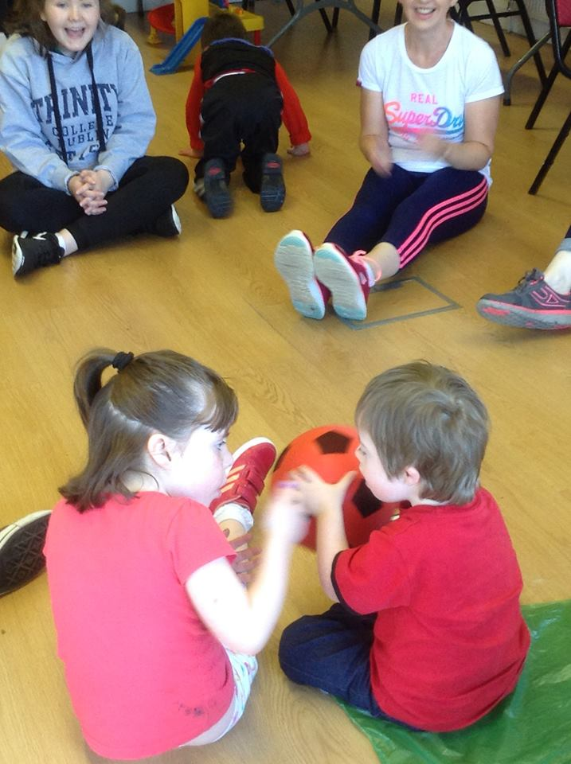
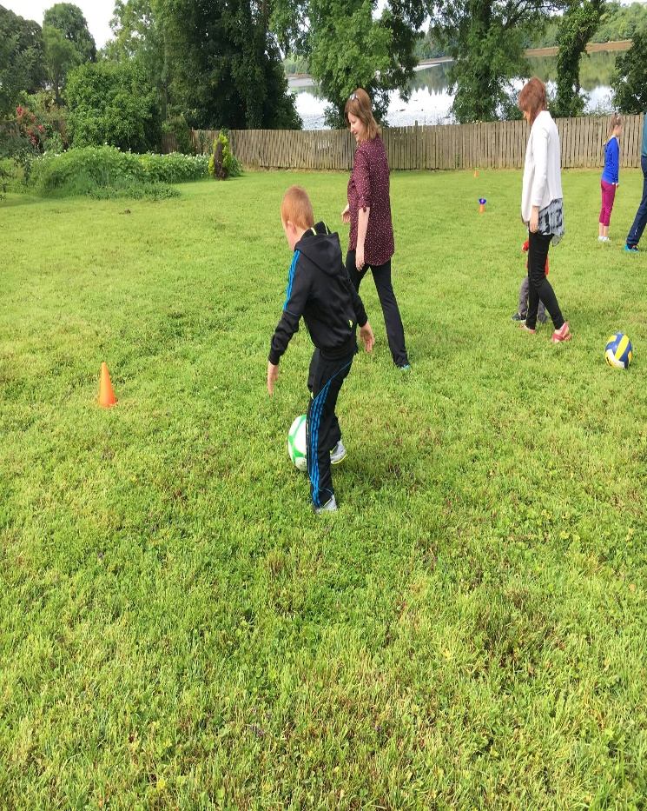
BLUESTACK SUMMER CAMP

Slide 13
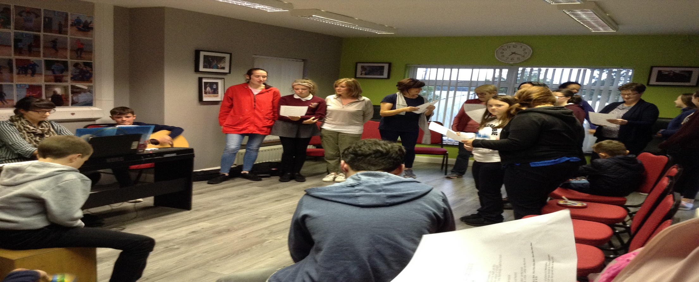
BLUESTACK CHOIR
MUSIC IS A UNIVERSAL LANGUAGE
IT IS A FULLY INCLUSIVE CHOIR – OPEN TO ALL
CELEBRATES ABILITY IN A REALLY FUN AND ENJOYABLE WAY

Slide 14
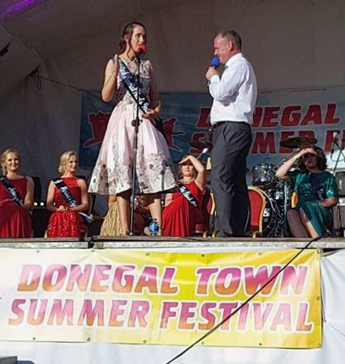
FAMILY SUPPORT
SIT ON A NUMBER OF MEITHEAL’S WITH THE CHILD
AND FAMILY AGENCY
PROVIDE OUTREACH FAMILY SUPPORT AND IN-HOUSE
SHORT TERM / EMERGENCY RESPITE
OFFER A BUDDY PROGRAMME – YOUNG PEOPLE
IN CARE
ACCESS TO BEHAVIOURAL SUPPORT SERVICES
ACCESS TO PLAY THERAPY SUPPORT

Slide 15
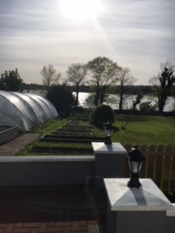
Low Cost Counselling/Well Being Project

Slide 16
Parents Support Network

Slide 17
CHANGING PLACES

Slide 18
A HELPING HAND AND A LISTENING EAR

Slide 19
SO HOW MANY ARE THERE?
WE HAVE 254 FAMILIES REGISTERED WITH US – 55 FAMILIES USE MORE THAN ONE SERVICE REGULARLY
WE WORK WITH FAMILIES WHO HAVE PHYSICAL, SENSORY, INTELLECTUAL AND MENTAL HEALTH DISABILITIES
REGARDLESS OF WHETHER THAT DISABILITY IS MILD, MODERATE OR PROFOUND
WE WORK WITH FAMILIES PRE AND POST DIAGNOSIS
HOWEVER, WE ARE NOT INTERESTED IN THEIR LABELS
WE RESPOND TO THEIR EXPRESSED NEEDS
WE WORK AS A COMPLIMENT TO EXISTING SERVICES SUCH AS MEDICAL AND EDUCATIONAL
WE WORK OUTSIDE NORMAL WORKING HOURS – OPERATE A SOCIAL MODEL
WE BELIEVE THAT HAVING A CHILD WITH ADDITIONAL NEEDS INCREASES THE STRESSES IN THE FAMILY – THUS THEY NEED MORE SUPPORT

Slide 20
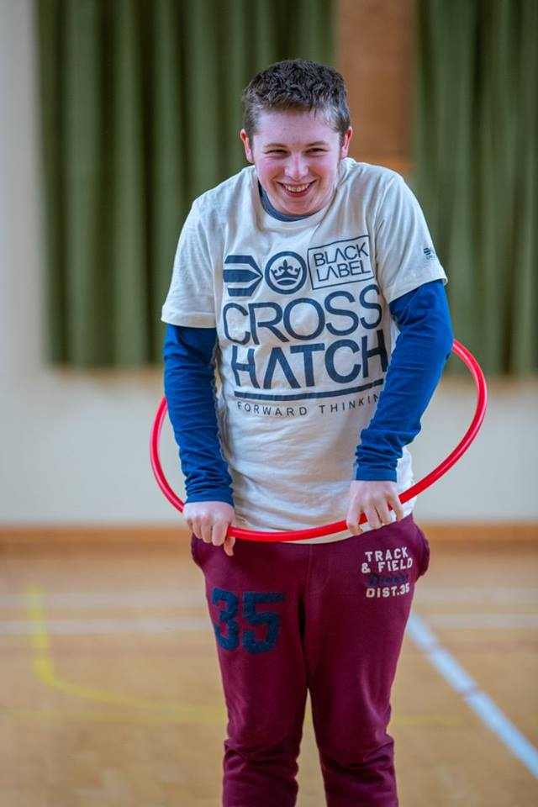
WE MEET SOME CHARACTERS IN OUR WORK – WITH GREAT ABILITIES

Slide 21
WE ARE A RESOURCE FOR YOU
WE OFFER AN INFORMATION SERVICE FOR PROFESSIONALS. MORE ARE COMING TO US FOR INFORMATION – THEY RECOGNISE THAT GENERIC OFFERINGS ARE NOT ALWAYS RELEVANT AND USEFUL BUT WITH A LITTLE TWEAKING THEY CAN BECOME INVALUABLE SUPPORTS.
WE NOW HAVE A WEALTH OF KNOWLEDGE LEARNED FROM OUR COLLECTIVE LIVED EXPERIENCE
PEOPLE RECOGNISE THE INADEQUACY OF SOME INTERVENTIONS/SUPPORTS/TRAINING PROGRAMMES IN DISABILITY SETTTINGS
SUCH AS PARENT PLUS – IGNORE BAD BEHAVIOUR / PRAISE GOOD BEHAVIOUR – HOW DOES THAT WORK WHEN A CHILD IS NON VERBAL, BEHAVIOUR IS THEIR COMMUNICATION
SUCH AS CHILDREN FIRST – WHAT CONSTITUTE INAPPROPRIATE BEHAVIOUR WHEN THERE IS A SENSORY PROCESSING DISORDER?
SUCH AS HEALTHY EATING – THE RULES DON’T ALWAYS APPLY TO PEOPLE WITH AUTISM
OUR CHILDREN AND YOUNG PEOPLE OFTEN JUST NEED A DIFFERENT APPROACH TO BEHAVIOUR MANAGEMENT
OUR FAMILIES NEED A DIFFERENT APPROACH TO PARENTING SUPPORTS

Slide 22
In Conclusion…
We ALL have a collective responsibility to support ALL children, ALL young people, ALL families. We have to work together
DISABILITY IS NOT AN ADD ON, WE CAN ALL MAKE OUR SERVICES MORE INCLUSIVE, MORE RELEVANT, MORE USEFUL.
So in Conclusion I hope that what we do in the Bluestack Special Needs Foundation might provide you with some inspiration around how we can all, each and every one of us in this room, can look at the services we provide and challenge ourselves on what we can do in our own jobs, in our own programmes to move from accepting diversity to embracing real inclusion.

Slide 23
PARTING WORDS

Slide 24
Thank you
BLUESTACK SPECIAL NEEDS FOUNDATION
THE GLEBE
DONEGAL TOWN
CO. DONEGAL
0749740828
WWW.BLUESTACKFOUNDATION.COM
Fb:

