Slide 1
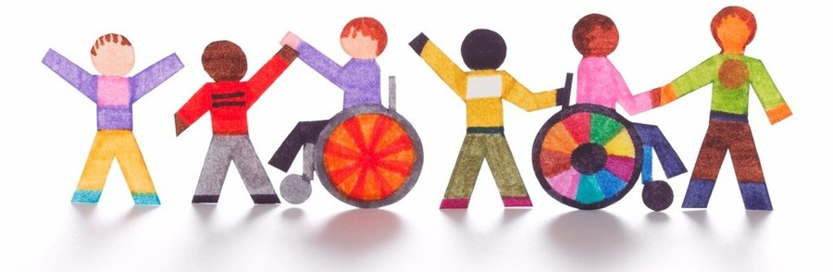
Re-Imagining Disability: From Diversity to Inclusion
Dr Bronagh Byrne
Centre for Children’s Rights/Disability Research Network
Queen’s University Belfast

Slide 2
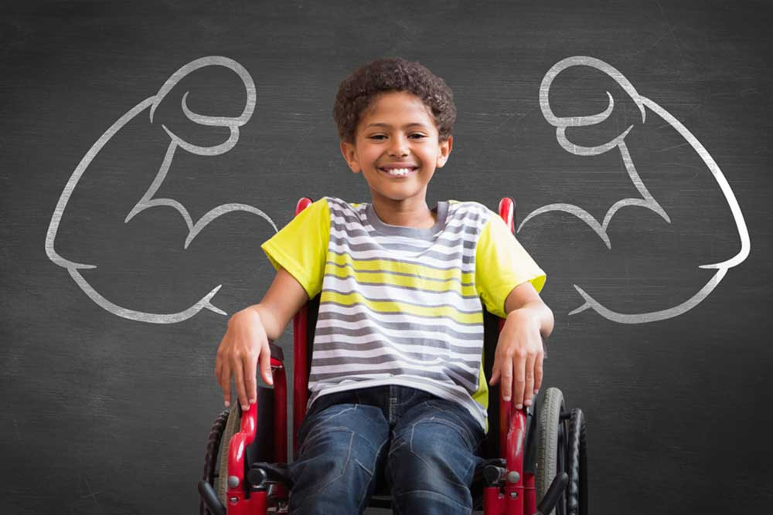
Why do we need to Re-imagine?

Slide 3
The Problem with Traditional Understandings of Disability

Slide 4
Inequality starts in childhood!

Slide 6
Is Recognising Diversity Enough?

Slide 7
What about Rights?
Rights as a bridge from diversity to inclusion
Article 23 UNCRC: Children with disabilities ‘should enjoy a full and decent life, in conditions which ensure dignity, promote self-reliance, and facilitate the child's active participation in the community.’
Article 7 UNCRPD: ‘States Parties shall take all necessary measures to ensure the full enjoyment by children with disabilities of all human rights and fundamental freedoms on an equal basis with other children.’

Slide 8
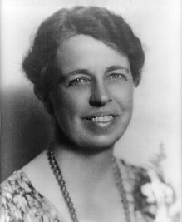
Rights start in the small places….
“Where, after all, do universal human rights begin? In small places, close to home - so close and so small that they cannot be seen on any maps of the world. Yet they are the world of the individual person; the neighborhood he lives in; the school or college he attends; the factory, farm, or office where he works. Such are the places where every man, woman, and child seeks equal justice, equal opportunity, equal dignity without discrimination. Unless these rights have meaning there, they have little meaning anywhere.” (Eleanor Roosevelt 1958)

Slide 9
So what is ‘Inclusion’?
Opportunities
Sense of belonging
Positive social relationships & friendships
Supported to develop potential
Communication
Voice
Access to services & supports
Participation in play & leisure

Slide 10
The Road to Meaningful Inclusion

Slide 11
The Road to Meaningful Inclusion
Relates to the ‘principle of full and effective inclusion and participation in society. It includes living a full social life and having access to all services offered to the public and to support services offered to persons with disabilities to enable them to be fully included and participate in all spheres of social life.’ (UNCRPD, General Comment, 2017, para 16)
‘Respecting the evolving capacities of children with disabilities and supporting them in having a say in choices that have an impact on them is critical.’ (UNCRPD General Comment, 2017 para 75

Slide 12
States parties should establish innovative forms of support and accessible services for children and adolescents with disabilities through personal contact or through their organizations. Children with disabilities may require support to practice sports or activities in the community with other children their age. Adolescents with disabilities should be enabled to spend time and take part in leisure activities with their peers. States parties must provide assistive devices and technologies that can facilitate the inclusion of adolescents with disabilities in their peer networks. Further, services that facilitate the transition of young people to adulthood, including support with moving out of the family home, starting employment and continuing into higher education, are crucial in supporting independent living.
(UNCRPD General Comment, 2017 para 76)

Slide 13
Concluding Thoughts
The way we imagine disability is changing and needs to continue to change.
It is not simply a medical issue, it is a rights issue
Disability is a fundamental facet of human diversity. It has always been and will always be part of the human condition.
By challenging our perceptions of disability, we can recognise, accept and respect children with disabilities, and continue the journey to meaningful inclusion

Slide 14
What would happen if we Re-imagined?
‘What would happen if our society fully recognized and validated human variation? What if we cultivated rather than reduced this rich distinctiveness? How would the public landscape change if the widest possible diversity of human forms, functions and behaviors were fully accommodated? How would such an understanding alter our collective sense of what is beautiful and proper? What would be the political significance of such inclusion?’
(Garland-Thomson, 2004)

Slide 15
Contact Details
Dr Bronagh Byrne
School of Social Sciences, Education and Social Work
Queen’s University Belfast
b.byrne@qub.ac.uk
Twitter: @BronaghByrneQUB

