Slide 1
Parent Hub Donegal from the perspective of one of the partner organisations and the Parent Hub Coordinator

Slide 2
How it all began..
In 2013, under the Children and Young People’s Services Committee and the Health and Well-being Sub Committee those working within parent and family support services identified the need for a one stop information point on all things parenting.
  We asked the question:- If you were a new to parenting or a parent new to Co Donegal what would make it easier for you to get parenting information and support?
We wanted to raise awareness about existing supports for all parents whether a birth parent, foster parent, adoptive parent, grandparent, guardian, or involved in caring or parenting a child or children. Whatever the challenge faced we hoped to be able to point parents in the right direction.

Slide 3
Who is involved…
Advanced Nurse Practitioner for Child Health and Parenting
Ante Natal Service Letterkenny University Hospital
Donegal Local Development Company
Early Intervention Team
Families Matter
Family Resource Centres
Foroige Teen Parent Support Programme
Health Promotion HSE
Home School Community Liaison
Inishowen Development Partnership
Letterkenny Youth and Family Service
Lifestart
ParentStop
Public Health Nursing Service
SpringBoard
Spraoi agus Sport
Tir Boghaine Teo
Tusla Child and Family Service (Social Care Leader)
Tusla Prevention Partnership and Family Support (Chair)
Membership is open and evolving

Slide 4
How it has developed..
The nature of the Parent Hub has been virtual - involving a wide range of partners working with and for parents.
All successes to date have been collaborative efforts of statutory and community/voluntary services who have a common focus of parenting support.

Slide 5
How it has developed..
For example:
  Successful Funding Applications to support parenting programme and coordination
    Parents Plus - Increasing Access to Parents initiative
    Katherine Howard Foundation: - Spirals Programme
    National Lottery - Parenting When Separated
    TUSLA Parental Participation Seed Funding 2016 – 2018 to recruit a Parent Hub Coordinator

Slide 6
How it has developed..
For example:
  Communications and Campaigns
    Make One Change Campaign
    Parent Information Fairs
    Media coverage on Parenting 24/7 key messages
    Parent Hub Facebook page
    Parent Hub Website

Slide 7
Where to next……
Parent Hub Donegal Action Plan developed including:
  exploring the needs and wants of parents in Co Donegal
  examining the gaps in provision
  smarter working to avoid duplication
Parent Hub Donegal Communications Strategy developed including:
  Raising awareness of the supports and information available for parents in Co Donegal
  Further developing the ‘one source’ point of information and support on ‘all things parenting’ in Co Donegal
  Commitment to make ‘all things parenting’ as accessible and inclusive as possible

Slide 8
Priority Areas Identified
Connecting Donegal parents to parent support and parenting programmes in their area
Coordination of Parenting Education and Support on a countywide basis
Parenting Information Website for Donegal
Increased access to Parent Support Programmes
Identified Suite of Parenting Programmes
Highlighting profile of existing supports
Parent’s as first educators and the home learning environment
Parenting Support
Evidenced based whole family skills programmes
Advocacy for families
Children living with parental substance misuse
Separated Parents and those co-parenting
Ante-Natal Parenting Support
Support for fathers

Slide 9

ParentHub Donegal
Facebook page
@Parenthubdonegal
Set up in June 2015
Over 1000 followers
Promotes local support services and events
Promotes Parent Programmes in the Community

Slide 10


Slide 11
Parent Hub Donegal
Website
www.parenthubdonegal.ie
Officially launched September 2016
One stop shop for parents/ families and professionals to access information about all supports/ services/ events available in Donegal
Home Page categorised by different stages providing information.
Services section : services mapped and categorised.
From Ante-natal to Youth Services to Counselling
A work in progress. Supported through Lar Thompson and Tusla based staff.

Slide 12
Make One Change Campaign 2014/2015/2016/2017

Slide 13
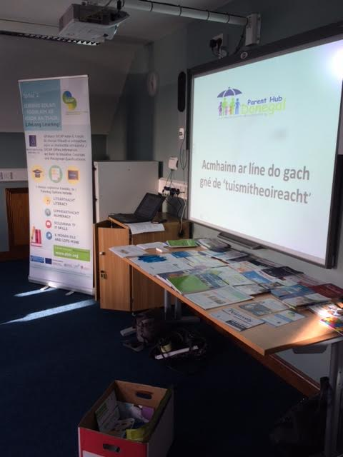
Ionad Naomh Pádraig Dobhair
25/04/17

Slide 14
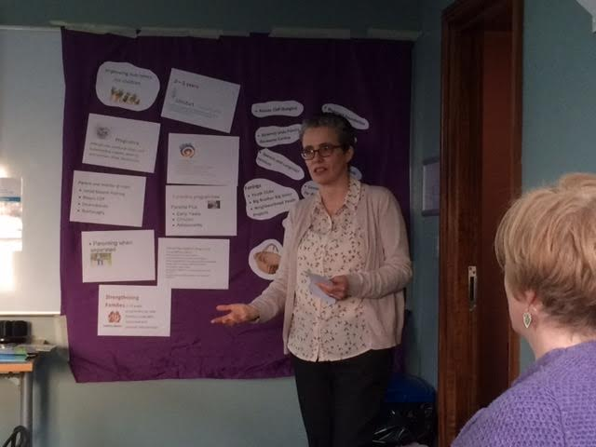

Slide 15
Sheol Parent Hub Dhún na nGall Parenthubdonegal.ie in 2016. Tá muid anois ag cuardach inchur ó thuismitheoirí fud fad Dhún na nGall chun cinntiú go bhfuil an t-eolas ar an suíomh chomh feiliúnach agus is féidir agus go bhfuil an t-eolas ag freastal ar riachtanais na dtuismitheoirí agus na dteaghlach. Bheadh muid fíor-bhuíoch dá líonfá an cheistneoir seo chun instint dúinn an t-eolas atá uait agus an tacaíocht, na cláir/seirbhísí srl a chuideodh leat mar thuismitheoir.
Cad é an trí réimse eolais nó cuidiú atá de dhith ort mar thuismitheoir?

Slide 16
Over 120 responses to date

Slide 17
What parents want – an initial assessment
Behaviour Management
Positive mental health – wellbeing, coping with stress
Weaning and nutrition
Teenagers – building good relationships, dealing with social media
Promoting children’s wellbeing – confident happy children
Anything to add?
Parenting courses in the evenings to suit parents who work

Slide 18
Contact Details:
Patricia Lee, Manager of ParentStop CLG – one of the partner organisation on the Parent Hub Donegal patricialee@parentstop.ie
Bairbre Cahill, Parent Hub Coordinator – appointed in March 2017 under the TUSLA Parental Participation Seed Fund
Bairbre.Cahill@hse.ie

Slide 19
Go raibh maith agaibh

