Slide 1

Sean Mc Grory : Jigsaw Donegal Project Manager
A: Jigsaw Donegal, Pearse Road, Letterkenny, Co Donegal
T: 07497 26920
E: sean.mcgrory@jigsaw.ie

Slide 2

“Is it only at the edge of the cliff that the crowds appear with nets?”
Notes:
Why is it that often times the approach in mental health is to wait until a problem has developed before we offer people a service?
As a former member of HS’s YAP once remarked – ‘is it only at the edge of the cliff that the crowds appear with nets?’
Why wait until things have gotten so bad to offer help. Why not intervene much earlier?

Slide 3

Jigsaw works to give young people support and options, at many points along the path, long before they ever get to the edge of the cliff.
Notes:
There is a need for services and supports at the point of crisis, at the edge of the cliff.
However, this is not where Jigsaw is positioning itself.
Jigsaw is focused on providing help much earlier, if possible (see quote)
Strengths based approach

Slide 4
Jigsaw: 3 Goals
1
3
Promote COMMUNITY ENGAGEMENT around youth mental health
Build mental health CAPACITY in those who work/volunteer with young people
2
Ensure ACCESS to youth friendly, integrated mental health supports
Notes:
Jigsaw is a complex community change strategy. (1)The Jigsaw hub or building is central to this by ensuring that yp can get support around their mental health in local, accessible, youth friendly environment. However, if HS is to achieve it’s aim of changing the way Ireland thinks about and responds to yp’s mental health, (2) then we must also build mental health knowledge and skills in those who work and volunteer with young people and in the wider community, i.e. parents, family, (3) so that the entire community raises their game in relation to mental health.

Slide 5
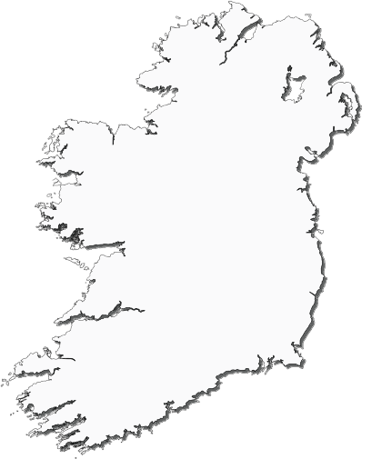


©Headstrong, 2012
Notes:
In order to answer the question about whether we should be worried about Mark or whether he’s just a typical teenager we need to know what is typical for young people in Ireland (CLICK)
To find this out a team of researchers from Headstrong & University College Dublin surveyed almost 14,500 young people aged 12-25 years from all over Ireland about their mental health. We asked them what was going on in their lives, how they were feeling, what was going well and not so well. This results of this survey, which is called the My World Survey, were published in May of this year (2012) and it is the largest survey of youth mental health every undertaken in this country.
It gives us a really good insight into what is normal or typical for our young people (NEXT)

Slide 6





Depression
almost
1 in 3
mild to severe depression
©Headstrong, 2012
Notes:
When we asked young people about feelings of depression, (CLICK) 1 in 3 young people reported levels of depression which fell within the mild to severe range. (NEXT)
(Note: Depression, anxiety and stress levels in young people were measured using the Depression, Anxiety & Stress Scale (DASS-21). This is a 21 item self report measure in which young people rated the intensity and frequency of negative emotions over the previous week. Based on their responses, young people were classified as displaying normal, mild, moderate, severe or extremely severe symptoms of depression, anxiety or stress.)

Slide 7

Anxiety
almost
1 in 3
mild to severe anxiety
©Headstrong, 2012
Notes:
Likewise, when we asked young people about feelings of anxiety, (CLICK) 1 in 3 young people reported levels of anxiety which fell within the mild to severe range.
This means that in any typical classroom of 30 pupils, 10 of them are experiencing levels of anxiety outside of what is considered the normal range;
where their anxiety is causing them a problem (NEXT)

Slide 8

Stress
1 in 4
mild to severe stress
©Headstrong, 2012
Notes:
When we asked young people about feeling stressed, (CLICK) 1 in 4 young people reported levels of stress which fell within the mild to severe range. (NEXT)
While it is good news that the majority of young people rated their depression, anxiety and stress as falling within the normal range, not causing them any problems,
it is worrying that a significant proportion of young people in Ireland today are feeling depressed, anxious or stressed. (NEXT)

Slide 9
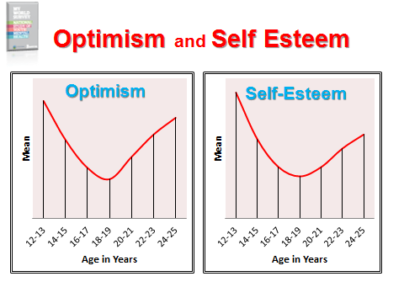

Slide 10
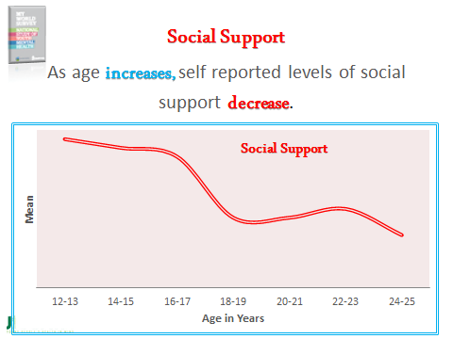

Slide 11
3 final points…
Those who share their problems enjoy better mental health
Not talking about problems is linked to suicidal behaviour
Many young people in distress are not seeking help
©Headstrong, 2012
Notes:
Finally, I want to tell you about 3 other important findings from the survey: (CLICK)
Those who share their problems and talk about them have better mental health than those who don’t talk and bottle things up.
A problem shared really is often a problem halved (CLICK)
2. 20% of young adults & 10 % of teenagers who are in distress are not seeking help. And this is especially worrying as (CLICK)
3. Not talking about problems is linked to suicidal behaviour
Now, that we have learned what is typical for young people in Ireland, let’s go back and check in with Mark again.
Since we last met Mark his girlfriend has broken up with him. So the kinds of thoughts going through Mark’s mind are: (NEXT)

Slide 13
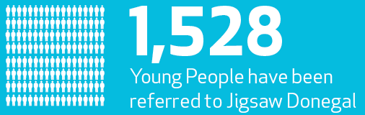
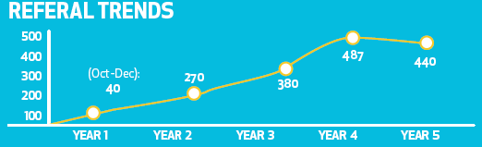

Slide 14
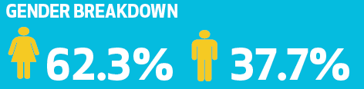
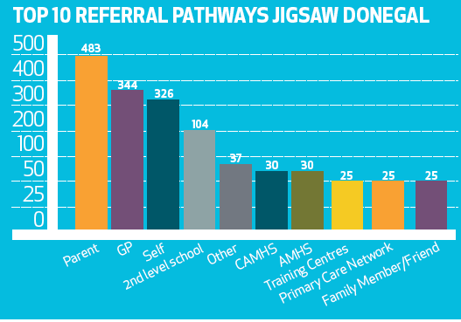

Slide 15
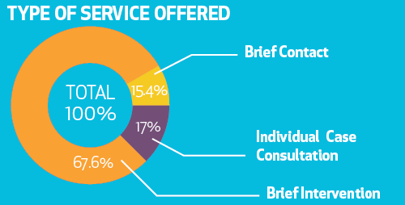

Slide 16
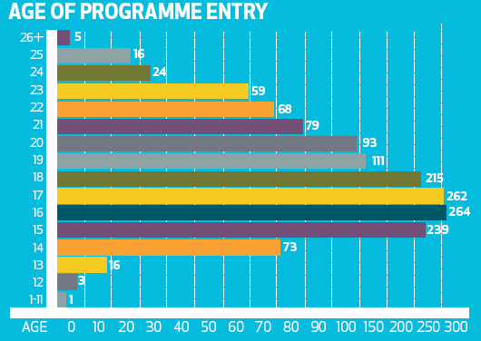

Slide 17
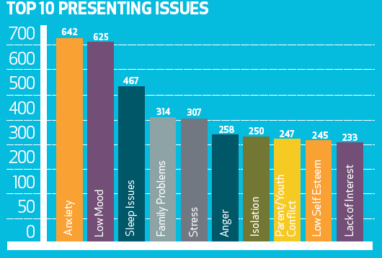

Slide 18
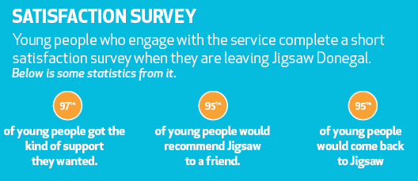


Slide 19
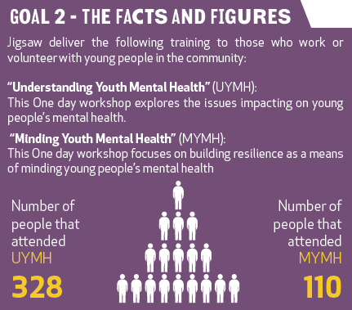

Slide 20
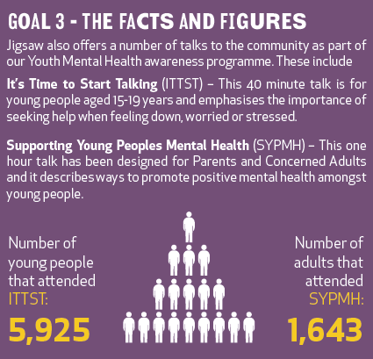

Slide 21
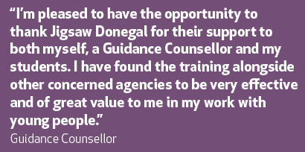

Slide 22

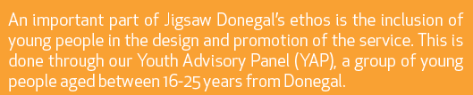
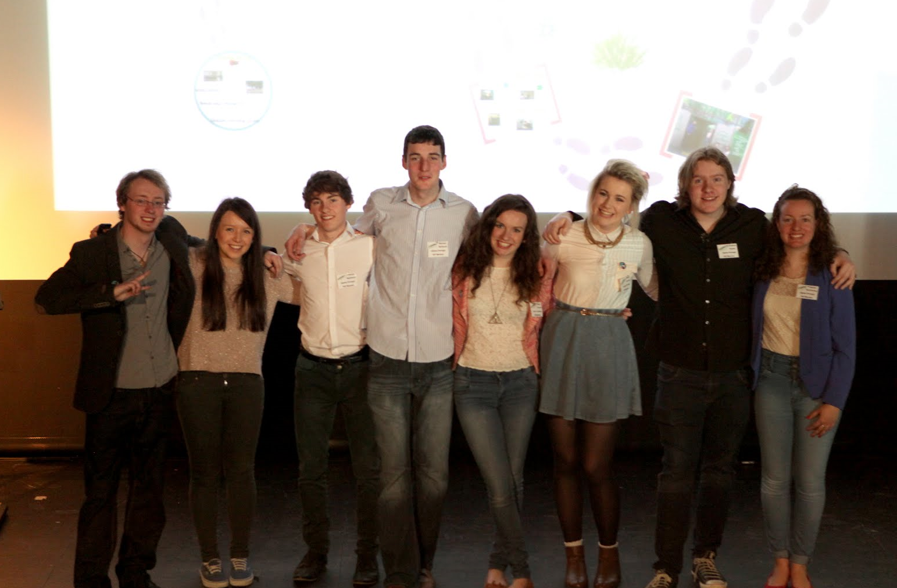

Slide 23
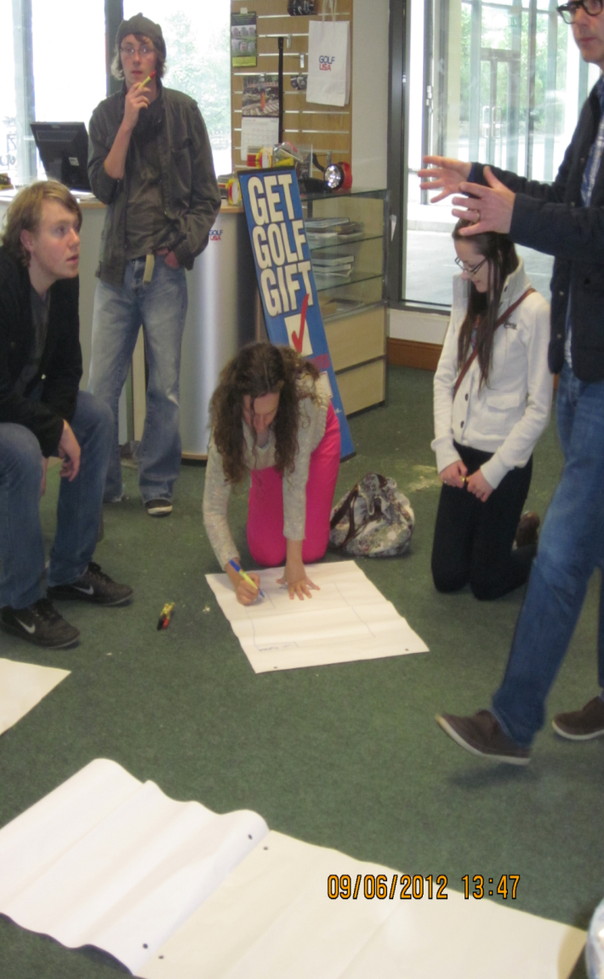
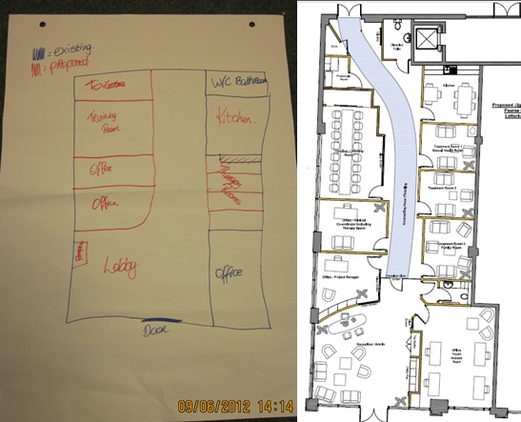
Design our Footprint

Slide 24
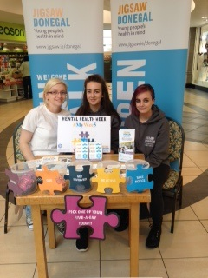
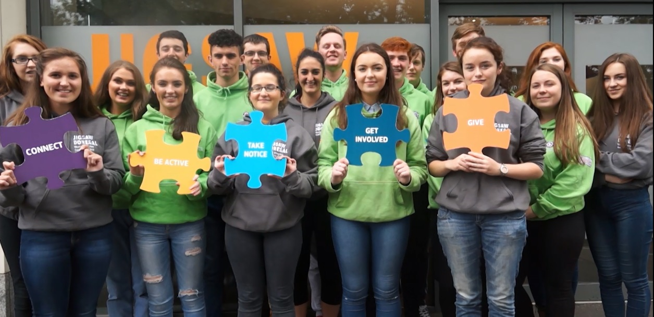
Promote our service as well as positive mental health

Slide 25
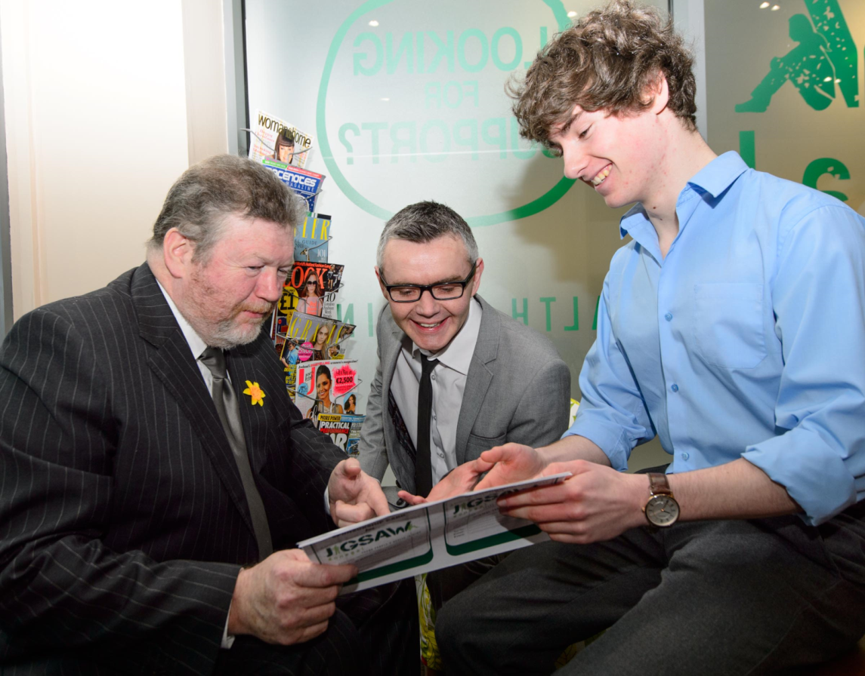
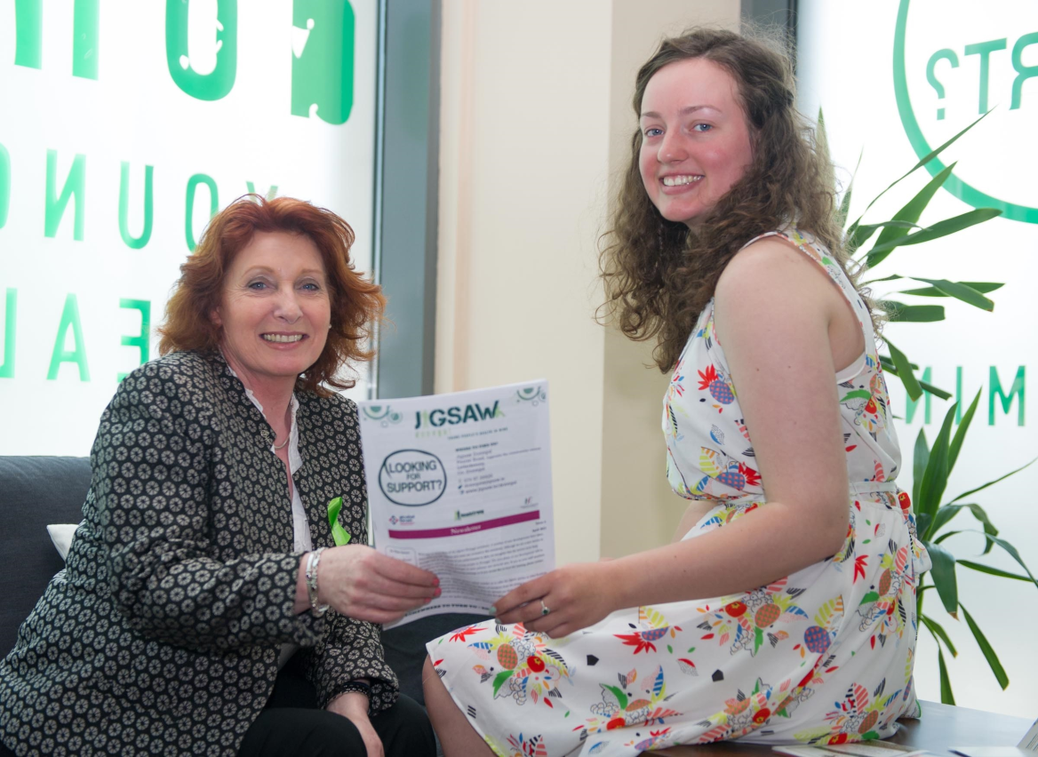
Represent the service to Ministers

Slide 26
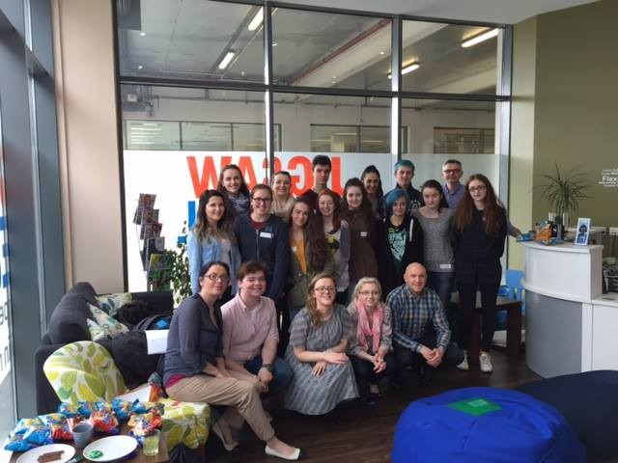
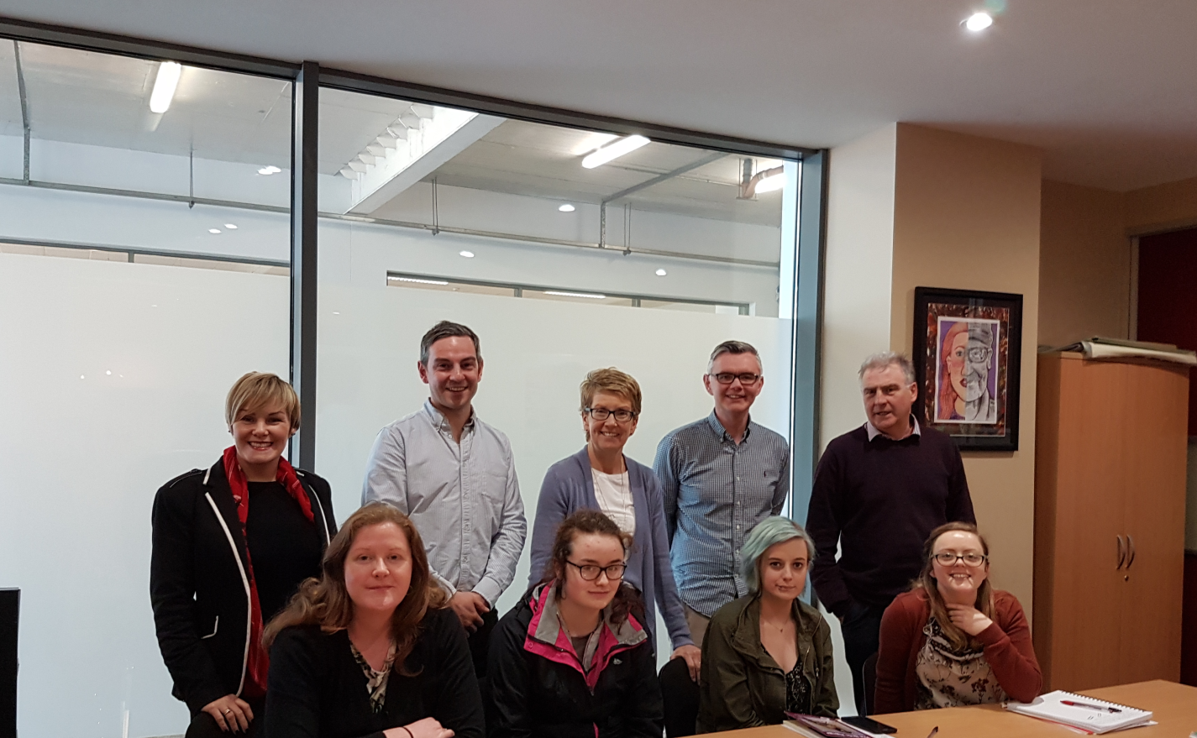
Work on joint projects with staff
Sit on our Management Structures

Slide 27

Virtual Tour

Slide 28
Thank you

