Slide 1

Donegal CYPSC
Subcommittee
Safe & Secure
Presented by
Inspector Michael Harrison- Garda Siochana
Paddy Muldoon – Donegal Education & Training Board
Gareth Gibson – Donegal Youth Service

Slide 2
National Outcome 3
Safe & Protected from Harm:
The aim for children & young People is that they are:
Have a secure, stable caring home environment
Are safe from abuse, neglect and exploitation
Are protected from bullying and discrimination
Are safe from crime and anti-social behaviour
Subcommittees under Outcome 3=
Safe & Secure est. 2012
Prevention Partnership & Family Support est. 2017

Slide 3
Safe & Secure Est. 2012 & Re constituted 2017
Members Organisations currently:
Garda Siochana
Tusla
Tusla COSC
HSE
Donegal Domestic Violence Service
Donegal Education & Training Board
Donegal Youth Service
Courts Service
Family Resource Centres Network
Donegal sports partnership
National Association of Principals and Deputy Principals

Slide 4
Children First
Objective:
Children First - create an awareness of CF Guidelines among all other organisations working with Children
Ensure all statutory and community & voluntary organisations will have a ‘Keeping Children safe’ Action Plan in Place.
Action:
CF Subcommittee established
Review of baseline of CF training in Donegal
Develop a template for Child Protection procedures ‘Keeping Safe Action Plan’
Developed information mechanism to collate relevant performance re CF Implementation

Slide 5
Domestic Violence
Objective:
Identify the risks for the victim & Children
Develop a structured system and referral pathway
Action:
Adapted the DASH form from that used by PSNI, New National Policy hopefully imminent.

Slide 6
Hidden Harm
Objective:
Increase the skills & knowledge base of agencies working with children who live with parental substance misuse
Raise Awareness
Action:
WG established
Design and delivered a 1 day training on recognising and responding to HH for professionals
HH protocol piloted & reviewed
Practice initiative with social workers and addiction staff
Delivered ‘Taking the Lid off’ – Rory & OiWillo training

Slide 7
Raise capacity to support Families within the legal system
Objective:
To offer information and training to staff working in the legal system- Courts, Judges, Solicitors, representatives
Action:
Delivered Information sessions & briefings across the legal professions linked to their Professional development
60 participants

Slide 8

Internet Safety
Objective:
Survey internet behaviour among young people
Action: Young People & Internet Survey
Survey carried out in co-operation with Donegal Youth Council across all secondary schools & a small number of Primary Schools.
191 Participants
Findings published in leaflet form in October 2015 by the Ombudsman for Children, Dr Niall Muldoon

Slide 9
Internet Survey Findings
Teenagers and young people from Donegal spend a significant amount of time on the Internet - the majority of them at least 2-3 hours daily
25% of children begin using it between ages 7 and 8
Females reported twice as much social media use as males
Females reporting greater knowledge of awareness of Internet Safety Information
43% of survey participants have met face-to-face with people they have first been in contact with on chat rooms, or by means of social media, with 22.5% of the sample having met 5 or more people
Up to 11% of acknowledged to have been “harassed, upset, bothered, threatened or embarrassed by someone on a social networking site, or chatting online” in the previous 6 months
Up to 32% of interviewed students acknowledged having been personally cyberbullied or to have a friend who has had this problem

Slide 10
Recommendations
At the launch Donegal Youth Councillors made further recommendations on how they would like to see some of the issues tackled, which included
More consistent education and training for young people about online safety through SPHE classes
Poster campaigns on internet safety
The introduction of a Web Safety week across Donegal schools

Slide 11
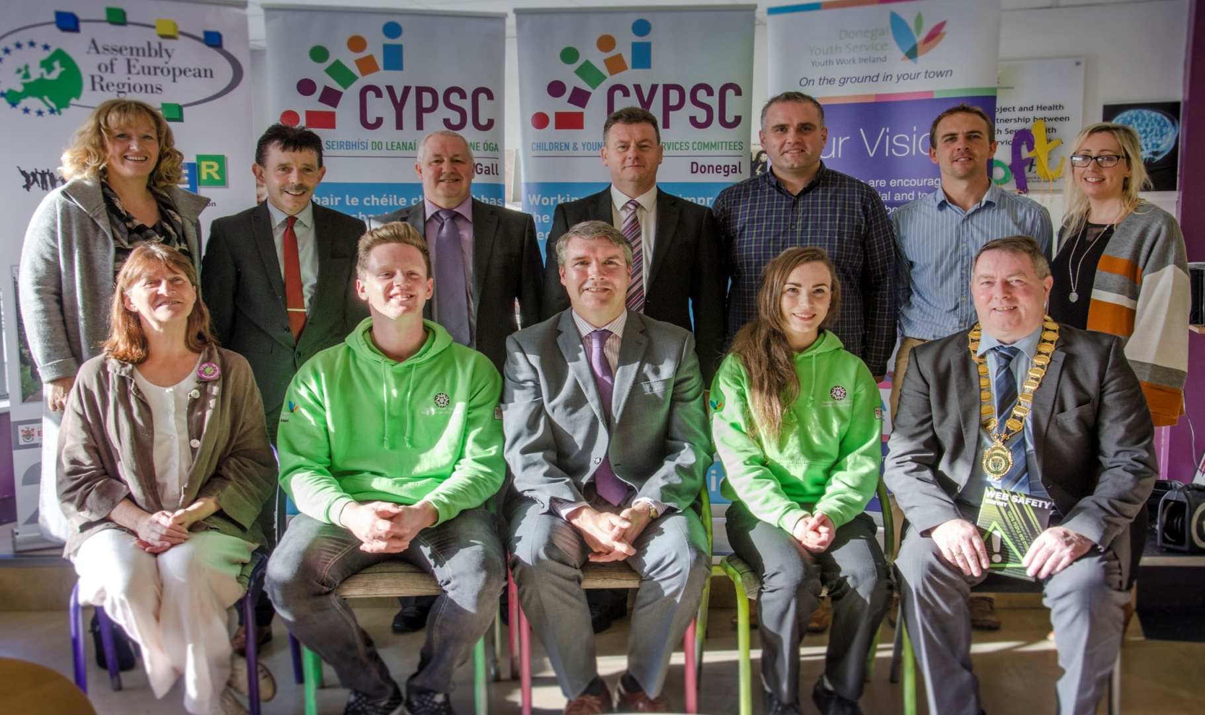
Launch of Web Safety Survey Results. Photo includes: Back L-r: Maria Mcinnes Regional Manager Tusla; Dr Martin Gormley, Education Officer Donegal ETB; Paddy Muldoon, Youth Officer, Donegal ETB; Seamus Neely, Chief Executive, Donegal Co Council; Martin Keeney, Co-ordinator, Donegal Youth Council; Gareth Gibson, Manager Letterkenny Youth Information Centre; Mchelle Maguire, Foróige.
Front L-r: Anne Mcateer, HSE Health Promotion (Co-ordinator, CYPSC); Eamon Conaghan, Chairperson, Donegal Youth Council; Dr Niall Muldoon, Ombudsman For Children; Aoife Gillespie Vice-chairperson Donegal Youth Council, Donegal Youth Council; Councillor Gerry Mcmonagle, Mayor Of Donegal Co Council.

Slide 12
Priorities Going forward ......
Addressing ongoing issues in implementing Children First
Addressing challenges in the Court system
Briefings for legal staff, court staff, Solicitors and Judges
Internet safety & Cyber bullying and revisit recommendations
24 hour Social work support to cover weekend and after 5pm. Awareness raising re Central number and where to go for help out of hours
Mental Health Services, out of hours
Addiction issues
Services for victims of crime
Information resource for victims of crime; What to do, Who to speak to, Information on what happens after reporting a crime, supports available.
Domestic Violence and impact of children & young people

