Slide 1
The Term So Far

Slide 2
The Election Process
Youth Councillors are voted on to the council through a democratic election process.
The elections are held independently in all of the post primary schools in October.
Students put themselves forward as potential candidates for the Donegal Youth Council, the Councillor is elected by their peers.
This is a mirror reflection of the Senior County Council election process.

Slide 3
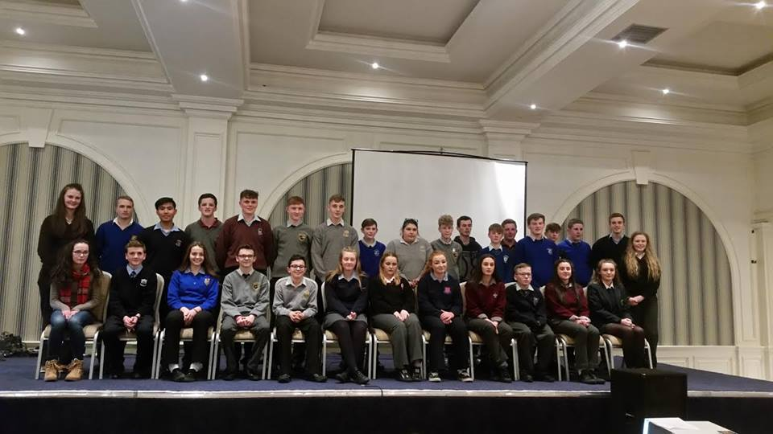
The Agenda Day
Our Agenda Day took place in the Clanree Hotel on the 9th of November. The class of 2016-2018 finally met each other.There were 99 young people in attendance across the county. We spent the day voting on the key issues facing young people.

Slide 4
TOP 4 RECOMMENDATIONS FOLLOWING VOTING PROCESS
SPORT More sports and Recognition for girls. Less competitive team sports with a focus on female participations with a fun element.
SEXUAL HEALTH & EDUCATION Raising Awareness of Mental & Physical Aspect of Sexual Health through surveying young people on their knowledge and campaigning.
FACILITIES Carry out a facility check to make sure toilets, sports facilities are of an appropriate standard and are hygienic for the students health. Then Take Action.
BODY IMAGE Organise Workshops on Self Esteem & Positivity in schools.

Slide 5
Road Safety Working Group meeting
Our first Road Safety Event took place in The Alley Theatre in Strabane in November. This was in conjunction with the Policing Community Safety Partnership Northern Ireland and the Road Safety Working Group.

Slide 6
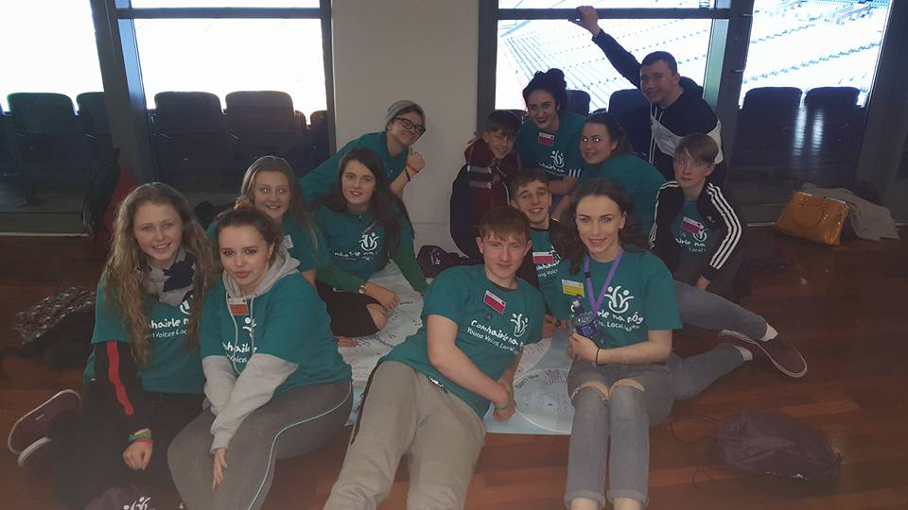
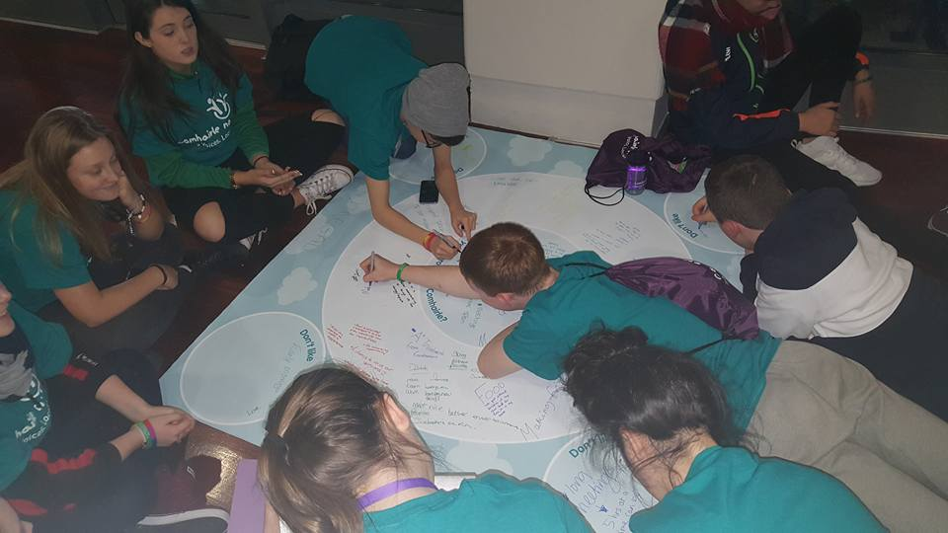
The National Showcase
15 Youth Councillors, past and present attended the National Showcase, Croke Park in Dublin in November. This event is a chance for the previous Comhairle’s to show all that they achieved during their term. This was a great chance for our councillors to see what they should be striving towards.

Slide 7
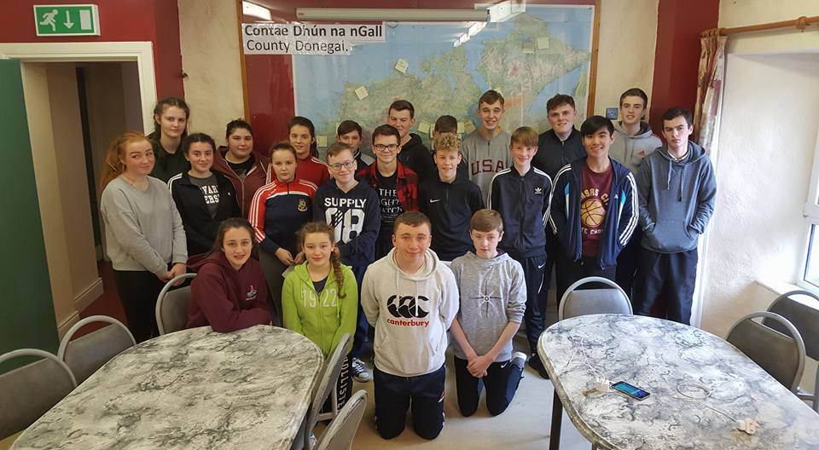
Residential
Our first Team builder was to Gartan Adventure Centre in icy December. We took part in water sports and lots of fun activities. We discovered we have many talented singers in the Youth Council. They sang into the wee hours, much to our Coordinators delight.

Slide 8
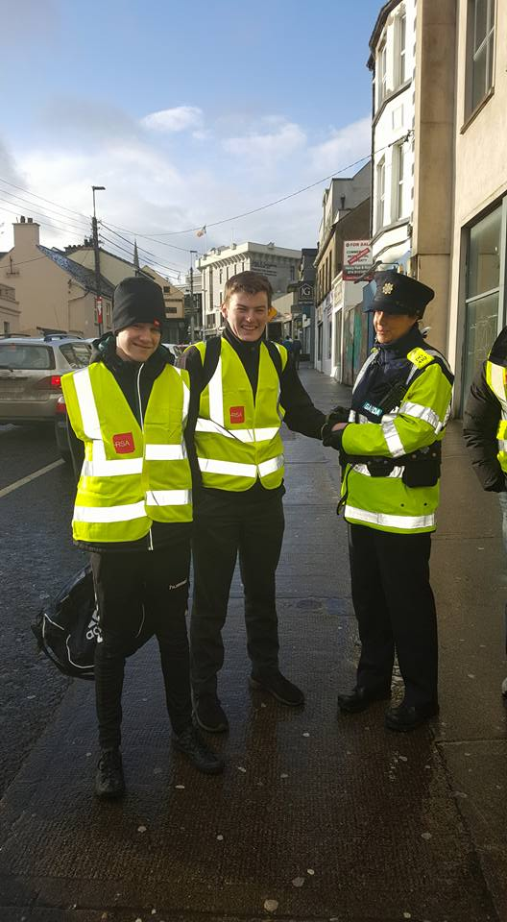
Be Safe Be seen campaign
We distributed over 1,500 High Visibility Material on the National Be Safe be seen day in December.

Slide 9
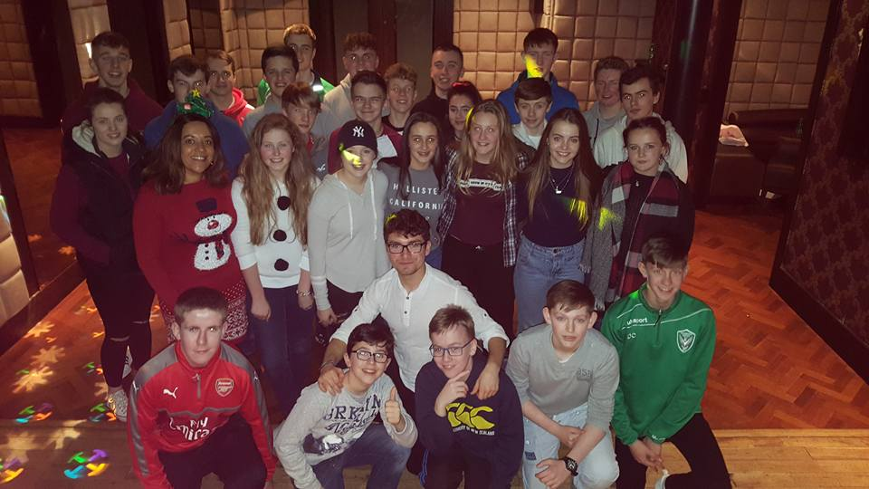
Christmas Party
Our Christmas party took place in the Grill Letterkenny after the last county meeting of 2016. Static Movement Dance Group taught us some hip hop moves. Fun times were had on the day.

Slide 10
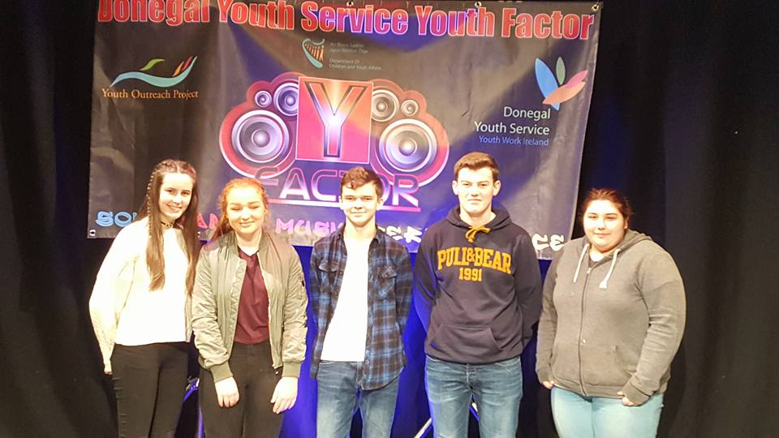
DYC Youth Factor
Singing their hearts out , Team DYC entered this year’s Youth Factor in January. Kai McHugh was successful on the day and made it through to the National Games in Limerick for Hip Hop.

Slide 11
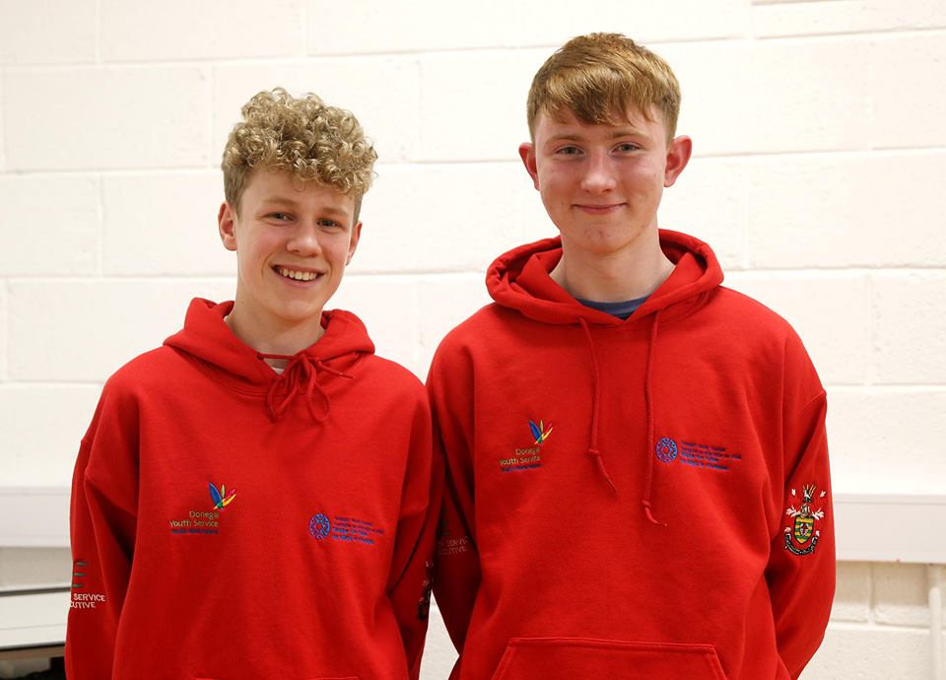
DYC Elections
At our county meeting in February we went Facebook Live to announce our Mayor & Deputy Mayor 2017. Seven Young people put themselves forward on the day and the two successful candidates are Padraig McGettigan and Conor Walker, representing St Eunan’s College Letterkenny.

Slide 12
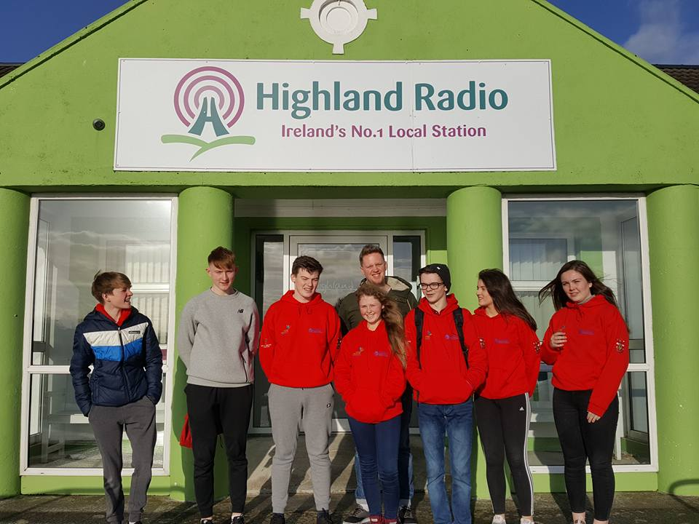
Radio Advertisments
A brilliant day for the Donegal Youth Council in Highland Radio. The Youth Councillors recorded Road safety Ads in association with the Road Safety Working Group. Drink Driving & Pedestrians were the themes on the day. This work will continue throughout 2017.

Slide 13
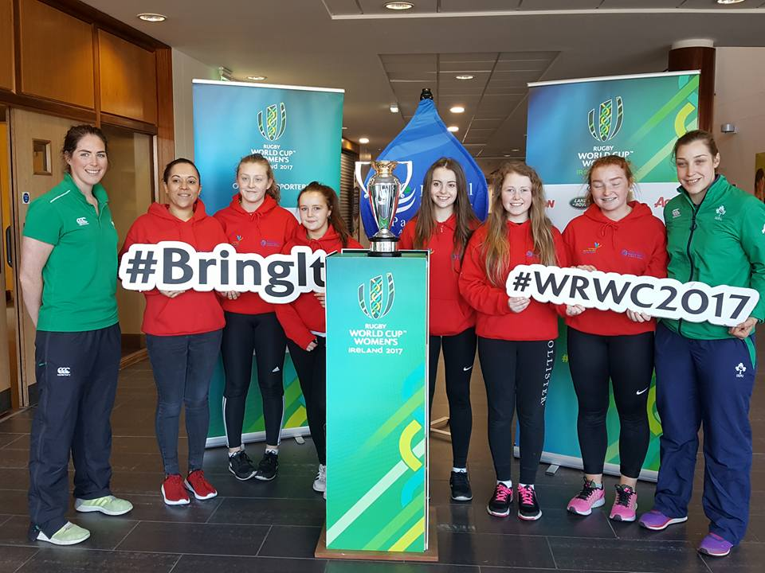
Girls Active
The Girls Active Event took place in the Aura in March. This event was organised by HSE Health Promotion. Female youth councillors helped with all aspects of the day.

Slide 14
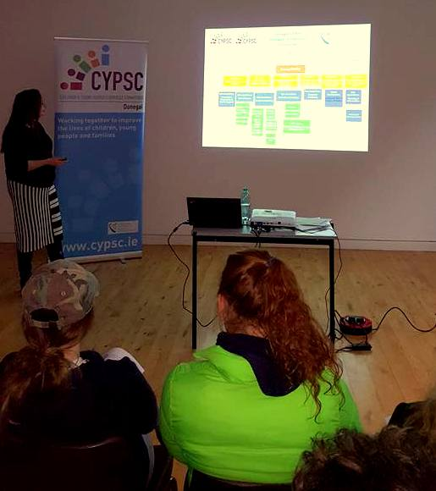
Ann Timoney Meehan from CYPSC presenting to the group.

Slide 15
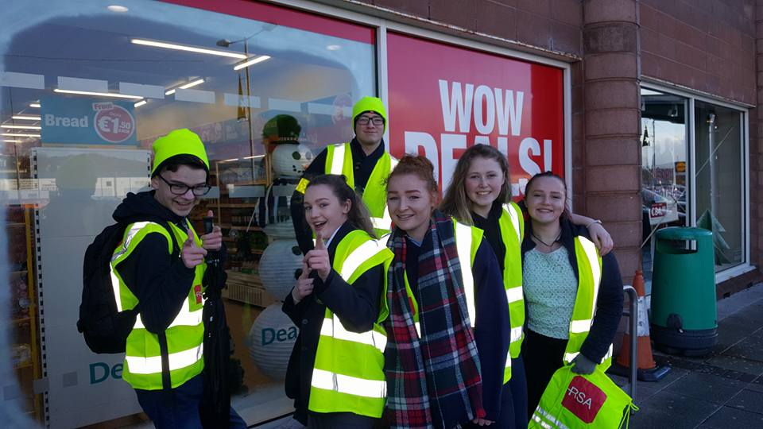
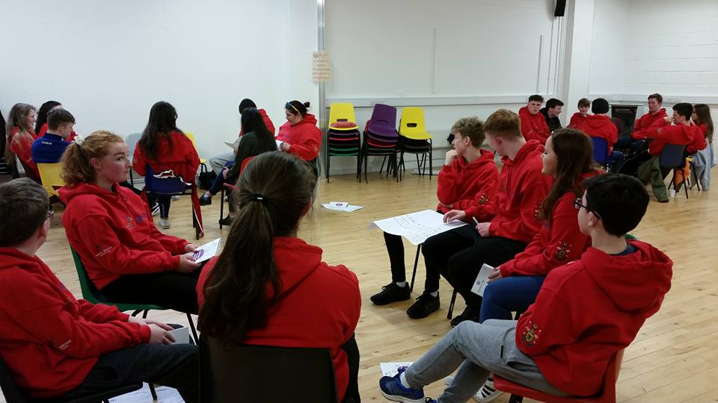
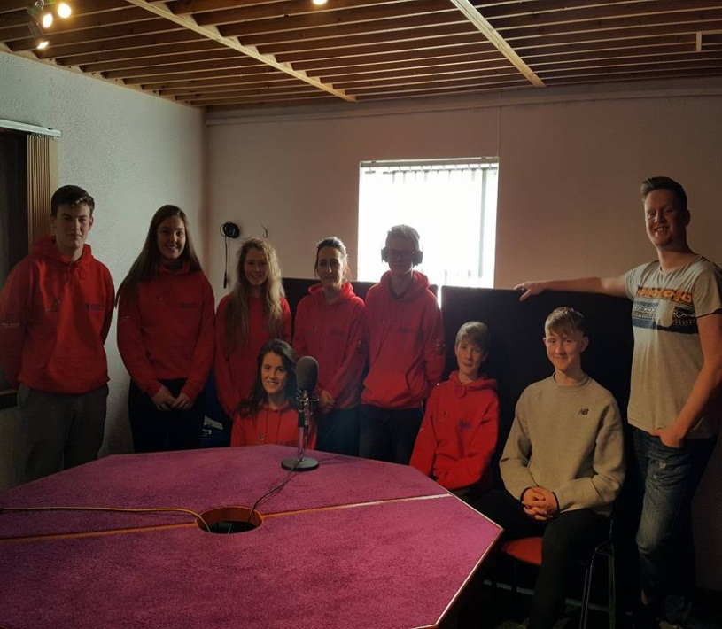
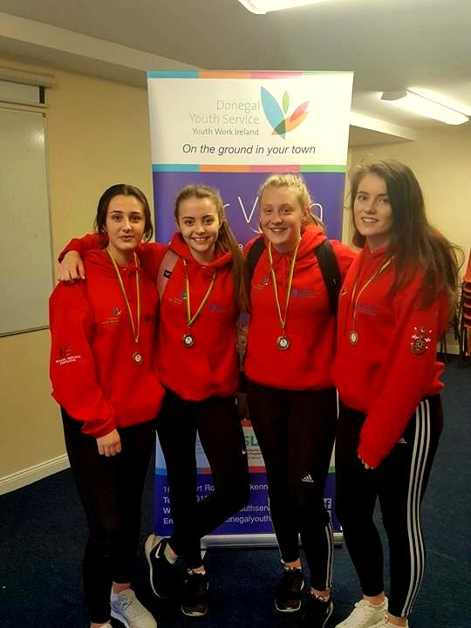
High Vis Day
Communication Training
Highland Radio
Limerick Games Champions

Slide 16
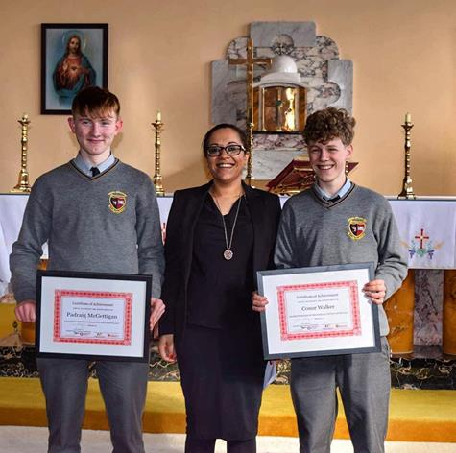
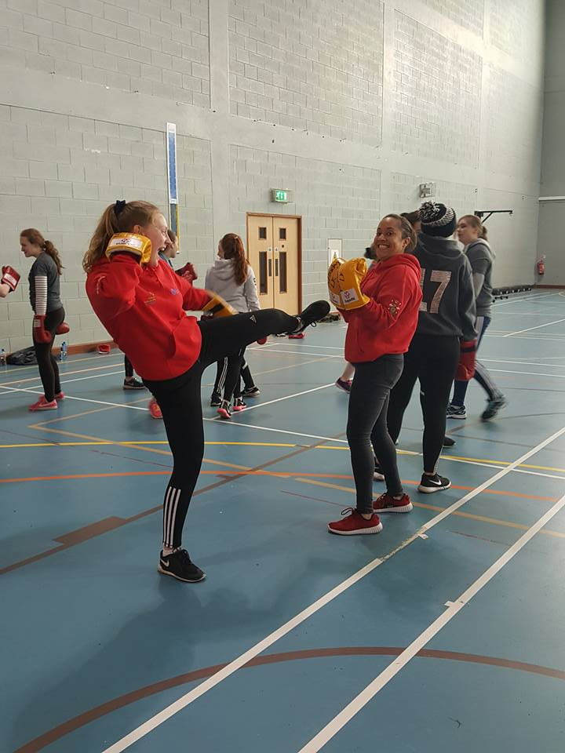
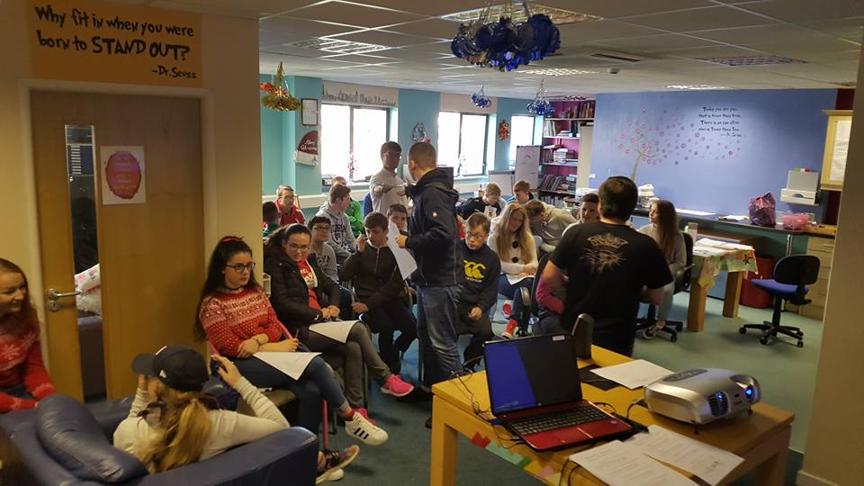
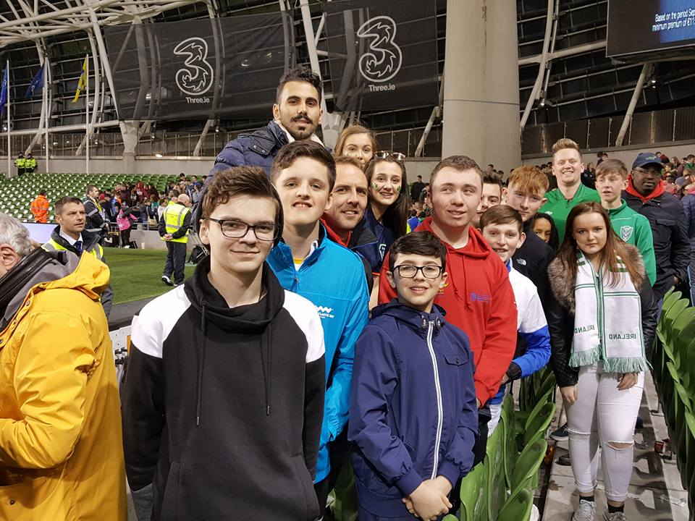
St Eunans College
Girls Active Event
Young Carers Meeting
AVIVA

