Slide 1


Special Needs Parent Support Group
Presented by: Leona McMenamin

Slide 2
About us
Mevagh Family Resource Centre was established in 1997 by a voluntary board of directors.
The board saw the need to develop services for families in the community so they applied for Family Resource Centre status which was granted in 2001.
The Centre run needs based programmes which concentrate on individuals and families in the Primary Care Team area of Milford/Fanad and Ros Goill.

Slide 3
Our Mission
To combat disadvantage by improving the functioning of the family unit and to promote the economic, social and cultural regeneration of the Mevagh community.

Slide 4
Services We Offer
Busy Bees, Parent, Baby & Toddler Group
Breast Feeding Support Group
Special Needs Support Group
Book Club
Junior Youth Club
Senior Youth Club
Womens Group
Men's Group
Men's Shed
Recreational Classes
Craft Group
Art Classes
Educational Classes
Parent Plus Training
Parent Stop
CV & Employment Support
Tourist Information Point
Library Services – Taobh Tíre
Administrative Services
Hot Desks / Computer use & internet access

Slide 5
Assess the Need
Devised a needs analysis of the local community.
Held an open evening for parents of children with additional needs to get their input on how the group could work to support them.
Evidence of lack of services in rural areas.
14% of Donegal's population have some form of disability (CSO 2011).

Slide 6
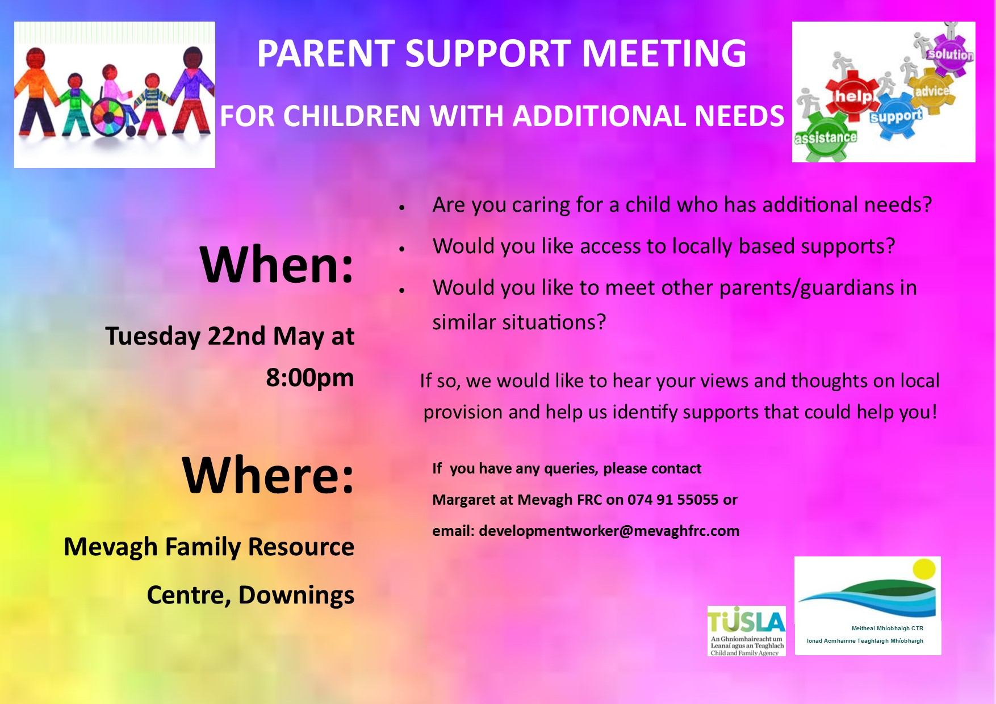

Slide 7
Setting Up Group
Arranged a meeting with two local Public Health Nurses and Speech and Language Therapist.
It was agreed from feedback of parents and professionals the group should not focus on one specific disability.
With the support of professionals we held a coffee morning for Parents who have children with Special Needs.
Discussions occurred with parents and we agreed a format for the group.
The group would be parent led and would meet monthly.
Mevagh FRC agreed to arrange training and provide a free space to accommodate group.

Slide 8
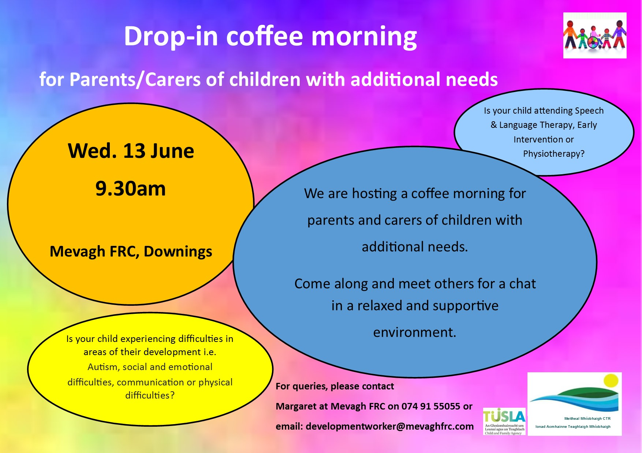
Continued

Slide 9
Continued
A support group within a Family Resource Centres is successful because we can address local needs with local responses in a holistic manner.
The role of the professional in parent support groups cannot be emphasised enough. The California module reports that “One third of self-help groups are started with the help of professionals.”

Slide 10
Benefits to Parents
Provide on-going support.
Help in time of crisis.
Learn additional coping skills.
Help focus anger and use its energy in positive ways.
Share information, ideas and resources.
Provide training for parents to increase skills.
Help in dealing with educational, medical and other service agencies.
Give an opportunity to relieve loneliness and form new friendships.

Slide 11


Contact Details
If you would like more information please contact:
Mevagh Family Resource Centre
Áras Ros Goill
Downings
Tel: 074 9155055
Email: info@mevaghfrc.com
www.mevaghfrc.org
Mevagh Frc
@Mevagh_FRC

