Slide 1
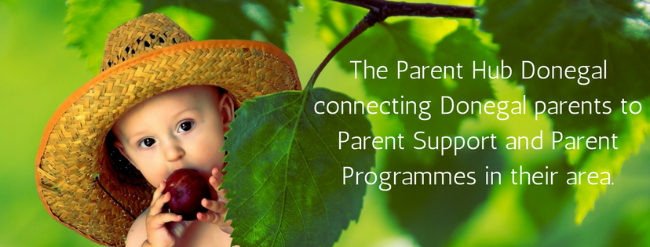

Slide 2
Providing a one-stop-shop for information, advice and support on all things parenting
Managing and developing the website http://parenthubdonegal.ie/ and Facebook page https://www.facebook.com/Parenthubdonegal/
Being a point of contact for parents and services – via phone, email and Facebook – directing towards suitable services and supports
Networking with parents – meeting with groups, 1:1 contacts, ongoing needs assessment, contacts through schools, support groups and services
Development of a database of bookings and referrals for Parents Plus programmes in order to work with services to coordinate the scheduling and delivery of programmes around the County
Promoting Parenting24Seven and campaigns that support positive parenting such as Make One Change
Notes:
Networking happens through my role as coordinator and through the diversity of services we have on the Parent Hub

Slide 3
Early Intervention Team
Autism services
Bluestack Foundation
Directory
of
Disability Services
in
County Donegal
Acquired brain injury Ireland
Donegal Down Syndrome Association
ParentStop
Disability Federation of Ireland
Epilepsy Ireland
Notes:
15,500 hits on the news site and over 35,000 hits on the services site and 8,000 people engage with Facebook posts over the last month alone

Slide 4
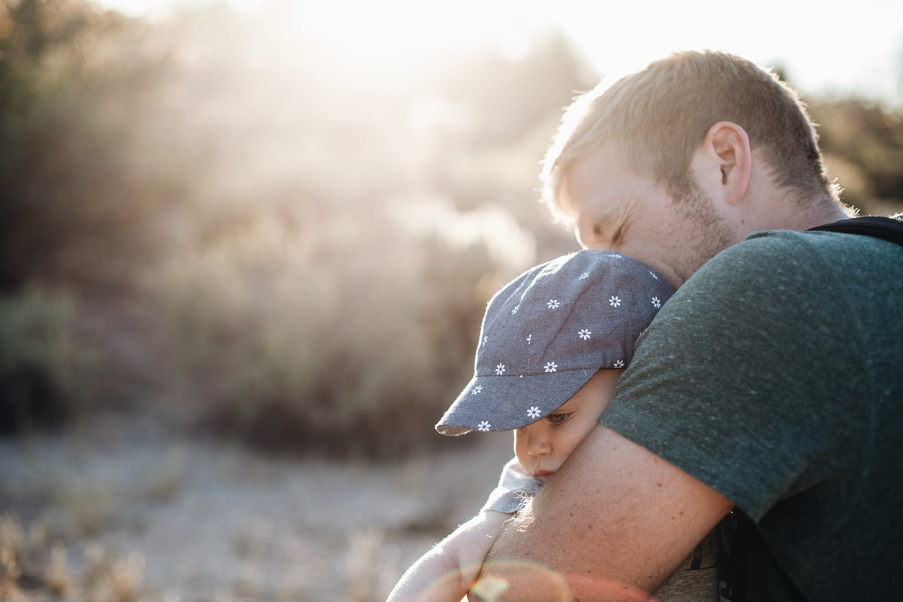
Parents Plus parenting programmes are evidence-based parenting courses promoting confidence, learning and positive behaviour in both parents and children.
Early Years Programme 1-6 years
Children’s Programme 6 – 11 years
Adolescent Programme 11 – 16 years
Working Things Out
Parenting When Separated
(coordinated by ParentStop)
Notes:
EY programme – being more tuned in as a parent, exploring child-centred play and communication, promoting children’s language and development, managing traumas and behavioural challenges. CP – encourages children’s learning and supporting homework, setting rules and keeping them, problem solving AP – positive communication, negotiating rules and boundaries, positive discipline and teaching teenagers responsibility, managing conflict and solving problems together. Working things out – an evidence based Cognitive Behavioural Therapy programme for teens promoting positive mental health and teaching coping skills to overcome specific problems. PWS – solving co-parenting problems, develop ways to cope with the emotional impact of separation and learn stress management techniques, enhance communication with the children and the children’s other parent.

Slide 5
Aim of the Parents Plus programmes
Being more tuned in as a parent
Supporting a child’s self esteem and confidence
Promoting language, learning and development including social skills
Establishing routines
Building cooperation and positive behaviour
Negotiating rules and boundaries with adolescents – teaching responsibility
Enabling parents to deal with misbehaviour and challenges in a positive and constructive way
Solving problems together
Managing conflict

Slide 6
What parents are saying about the programmes
I honestly feel the group was amazing, and the way I felt supported as I don’t like talking in public
I’m starting to use the reward chart and playing more with my child, 1:1 play and letting him take the lead
I have got my children to get on with each other better and stop trying to get one another into trouble
The course has given me confidence to stand by the choices I have made for me and my children
I feel I have made great progress. I am more aware and use ‘pause’. My relationship with my kids has improved.
I can communicate better. I can listen again. I can encourage more. We are a happy family again!

Slide 7
Upcoming programmes
PPEY Raphoe
PPCP Carndonagh IDP 16th October
PPAP Donegal FRC/Tír Boghaine October 9th
PWS Letterkenny ParentStop 6th November
PPAP possibly in Letterkenny
PPCP possibly in Ballyshannon
SOOC Manorcunningham 7th November
SFP teen group currently running in Letterkenny
SFP children’s group planned
YPSP LYFS/National Family Support Network
Notes:
YPSP – Young Person’s Support Programme

Slide 8
We are confident that every family could benefit from a parenting programme and we want to make programmes more universally accessible
Parent Hub Donegal works on the basis that the universalisation of parenting programmes fits within the goals of Better Outcomes, Brighter Futures
Transformational Goals
Goal 1: Support parents
Goal 2: Earlier intervention and prevention
Notes:
If we want National Outcomes for children and young people to be realised we need to engage with the Transformational Goals.

Slide 9
The Wheel Training Fund – providing training in
Lifestart Spirals
Parents Plus Early Years
Parents Plus Children’s programme
Parents Plus Working Things Out
Parents Plus Adolescent programme
Parenting When Separated
Additional training
With Parents Plus – facilitating the programme in complex situations
With the Alcohol Forum – exploring the impact of alcohol on family life and parenting
With the Middletown Centre for Autism
With local experts – facilitating the programmes in situations of additional need

Slide 10
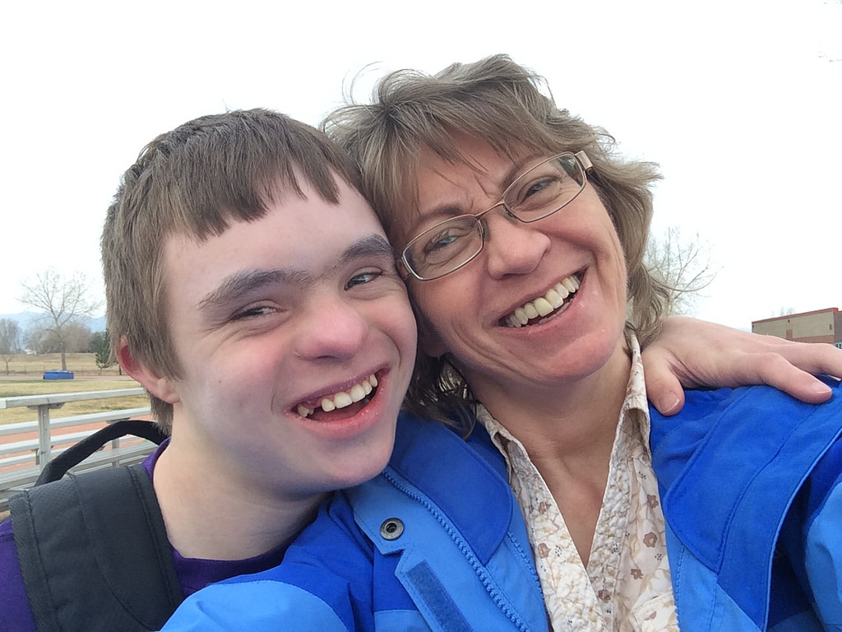
Working together to make parenting support relevant and accessible to all families
Participants from
Donegal Down Syndrome
Letterkenny Autism Family Support
Bluestack Foundation
Parents Plus Disability Research Project – in conjunction with Trinity College
Increasing
Geographical reach
Cultural diversity
Diversity of supports
Strengthening Families programme
SOOC
Notes:
In conjunction with Trinity College Dublin, Parents Plus are starting a new research project to evaluate the delivery of the Parents Plus programmes in disability settings, with the goal of:
Understanding what works in the delivery of Parenting groups in disability settings
Identifying what adaptations and additional material is needed in groups
Informing the development of disability specific Parents Plus Programme

Slide 12
www.Parenthubdonegal.ie
Parenthub Donegal
Bairbre.parenthub@gmail.com
Bairbre 087 1736667

