Slide 1
Sexual Wellbeing
Resource Pack for 2023

Slide 2
Sexual Wellbeing resources
The HSE Sexual Health and Crisis Pregnancy Programme (SHCPP) has a number of resources.
In 2022, two free sexual health services were announced by Government – a new free contraception service and a national home STI testing service. Posters and guides about these new services are available in this pack.
The Sexual Wellbeing campaign has also produced three new video series to promote awareness of new and existing free sexual health services. More information about these series is available in this pack.

Slide 3
What’s in this pack
Free condoms and lube available from the HSE National Condom Distribution Service (NCDS)
About HealthPromotion.ie
Order condom promotion posters
Order free home STI testing posters and business cards with QR codes
Order free contraception posters
Order free My Options leaflets and posters
Order sexual wellbeing guides and leaflets
Sexual Wellbeing social media accounts and Social Content

Slide 4
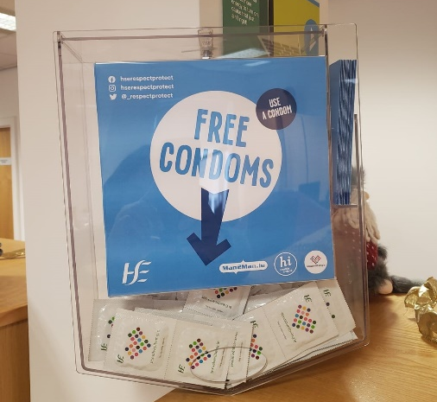
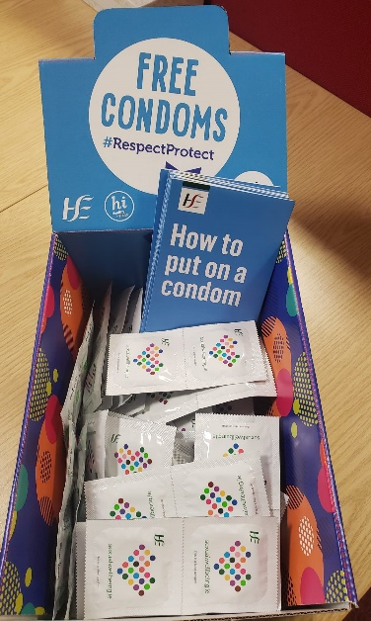
1. Free condoms and lube
The National Condom Distribution Service (NCDS) distributes free condoms and lubricant sachets to services working directly with population groups who may be at increased risk of unplanned pregnancy, HIV or STIs.
Visit this page to complete an application form and order your free supply of condoms if you are not registered with this service.

Slide 5
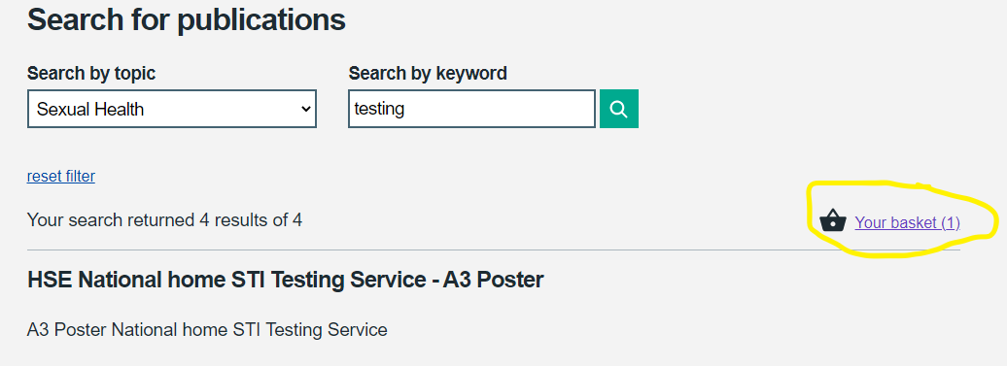
2. HealthPromotion.ie
The HSE produce and distribute a wide range of health related resources, including sexual health posters and guides. These are all available to order on HealthPromotion.ie
If you have not used HealthPromotion.ie in the past, you will need to set up an account. Simply complete a short sign up form on this page.
Once you have signed in, use the search function to browse through all resources available. To order a resource, input the quantity you need, and click “Add to basket”.
Once you are ready to place an order click the basket icon to confirm and complete your delivery details.

Slide 6
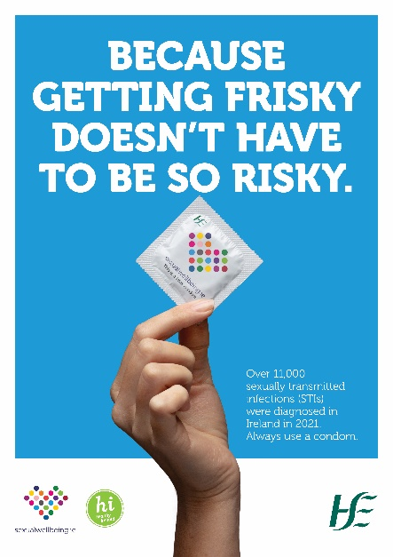
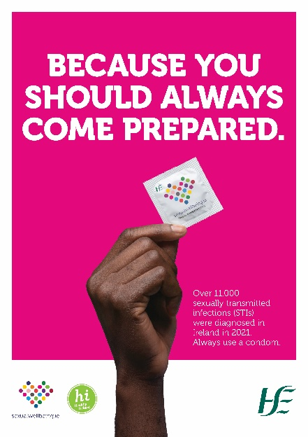
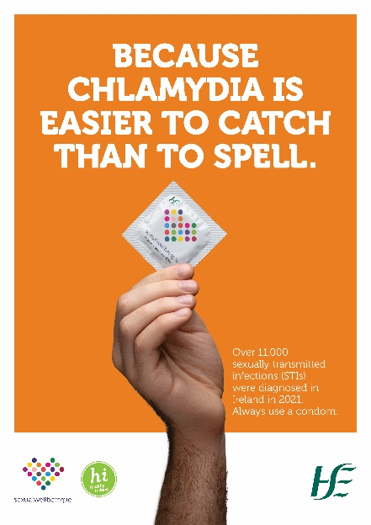
3. Condom promotion posters
Condom promotion posters are available to order on HealthPromotion.ie by searching topic [Sexual Health] and keyword [Condom]

Slide 7
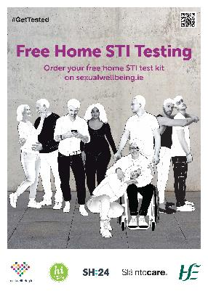
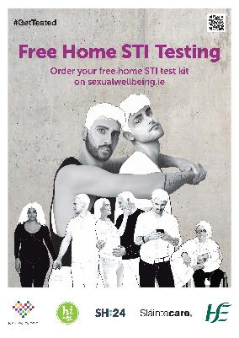
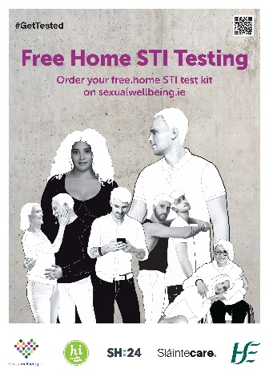
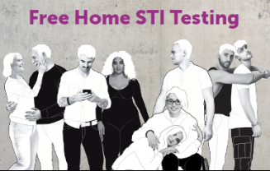
4. Free Home STI Testing posters and business cards
Free home STI test kits are available to order from Sexualwellbeing.ie. This service is now available nationwide.
Posters and business cards to promote this free service are available to order on HealthPromotion.ie.
Search by topic [Sexual Health] and keyword [STI testing]

Slide 8
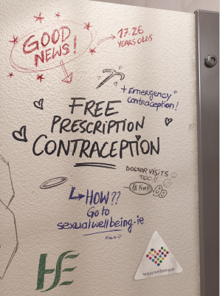
5. Free contraception posters
Prescription contraception and emergency contraception is available for free for 17 to 26 year olds.
It is available for women and people with a uterus within this age range.
Posters advertising the free contraception services are available to order on HealthPromotion.ie
Search by topic [Sexual Health] and keyword [Contraception]
12345

Slide 9
6. My Options posters and leaflets
My Options is a HSE service that offers confidential counselling and information if you’re experiencing an unplanned pregnancy.
Visit myoptions.ie for more information.
My Options leaflets are available to download now or to order directly from HealthPromotion.ie
The leaflets are available in 16 languages.
Search by topic [Sexual Health] and keyword [My Options]

Slide 10
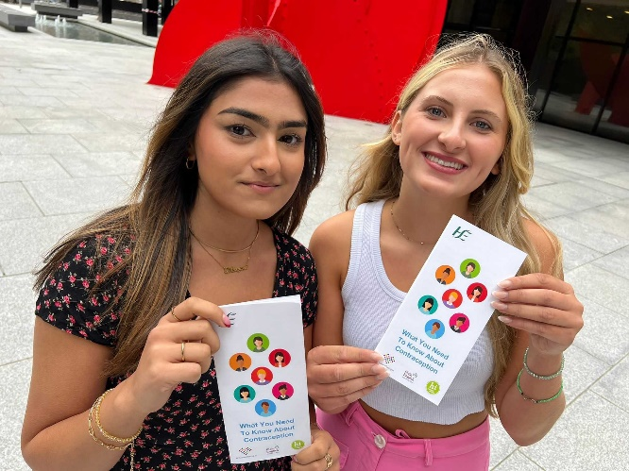
7. Sexual health guides and leaflets
HealthPromotion.ie also has lots of guides available to order such as ‘What you need to know about Contraception’ and the ‘STI booklet’. Both guides are available in several languages.
Browse through the range of resources available to download or order on HealthPromotion.ie by searching the topic: “Sexual Health”
12345

Slide 11
8. Social media video series
The Sexual Wellbeing campaign has recently partnered with University of Galway Students Union and MTU Cork Students Union, to produce two videos series to promote the new free services, such as free home STI testing, free contraception, and existing services like My Options.
These are targeted towards a younger (18-24) demographic, promoted on Instagram Reels and TikTok primarily, but are also relevant for a wider audience.
The ‘free sexual health services’ series with MTU Cork is live on Sexual Wellbeing social media now and will run until April.
A video series about contraception will be promoted later in April/May 2023. This was filmed with Dr Ciara McCarthy ICGP/HSE GP Clinical Lead in Women’s Health.
Please feel free to share this content on your own social platforms, tagging the Sexual Wellbeing social media accounts.

Slide 12
Social Media handles
You can find Sexual Wellbeing on the following platforms:
Twitter: @_respectprotect
Facebook: @Sexual Wellbeing
Instagram: @hserespectprotect
Tiktok: @sexualwellbeing.ie
Website: sexualwellbeing.ie

Slide 13
HSE Sexual Wellbeing campaign contacts
If you have any questions about accessing resources or would like support for future sexual health and wellbeing activity, here are some relevant contacts:
HSE Sexual Health & Crisis Pregnancy Programme, Communications Lead: Anita Ghafoor-Butt anita.butt@hse.ie 087 350 1587.
HSE Communications Division, Campaign Manager: Muireann Kirby muireann.kirby@hse.ie 087 749 9683.

